Slide 1
Chapter 4
Relational Databases

Slide 2
Learning Objectives
Explain the importance and advantages of databases.
Describe the difference between database systems and file-based legacy systems.
Explain the difference between logical and physical views of a database.
Explain fundamental concepts of database systems such as DBMS, schemas, the data dictionary, and DBMS languages.
Describe what a relational database is and how it organizes data.
Create a set of well-structured tables to store data in a relational database.
Perform simple queries using the Microsoft Access database.

Slide 3
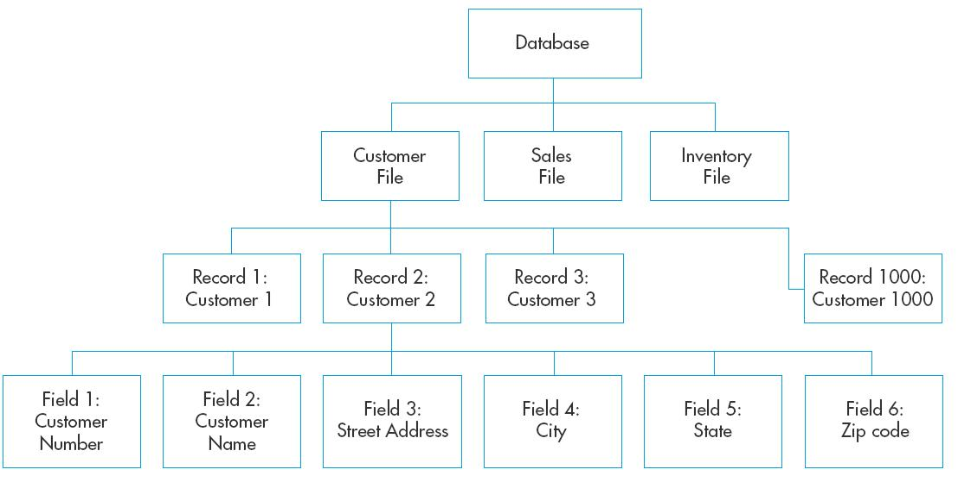
Data Hierarchy
Field
  Attributes about an entity
Record
  Related group of fields
File
  Related group of records
Database
  Related group of files

Slide 4
Advantages of Database Systems
Data Integration
  Files are logically combined and made accessible to various systems.
Data Sharing
  With data in one place it is more easily accessed by authorized users.
Minimizing Data Redundancy and Data Inconsistency
  Eliminates the same data being stored in multiple files, thus reducing inconsistency in multiple versions of the same data.
Data Independence
  Data is separate from the programs that access it. Changes can be made to the data without necessitating a change in the programs and vice versa.
Cross-Functional Analysis
  Relationships between data from various organizational departments can be more easily combined.

Slide 5
Database Terminology
Database Management System (DBMS)
  Interface between software applications and the data in files.
Database Administrator (DBA)
  Person responsible for maintaining the database
Data Dictionary
    Information about the structure of the database
      Field names, descriptions, uses

Slide 6
Logical vs. Physical
Physical View
  Depends on explicitly knowing:
    How is the data actually arranged in a file
    Where is the data stored on the computer
Logical View
    A Schema separates storage of data from use of the data
    Unnecessary to explicitly know how and where data is stored.

Slide 7
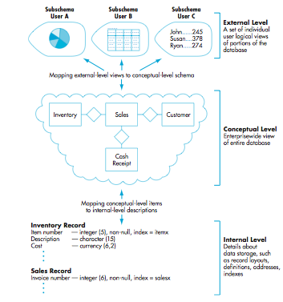
Schemas
Describe the logical structure of a database
  Conceptual Level
    Organization wide view of the data
  External Level
    Individual users view of the data
    Each view is a subschema
  Internal Level
    Describes how data are stored and accessed
      Description of: records, definitions, addresses, and indexes

Slide 8
DBMS Languages
Data Definition Language (DDL)
  Builds the data dictionary
  Creates the database
  Describes the subschema
  Specifies record or field security constraints
Data Manipulation Language (DML)
  Changes the content in the database
    Updates, insertions, and deletions
Data Query Language (DQL)
  Enables the retrieval, sorting, and display of data from the database

Slide 9
Relational Database
Relational data model represents the conceptual and external level schemas as if data are stored in tables.
Table
  Each row, a tuple, contains data about one instance of an entity.
    This is equivalent to a record
  Each column contains data about one attribute of an entity.
    This is equivalent to a field

Slide 10
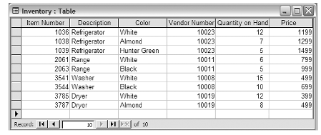
A Relational Table
Row (Record)
Column (Field)
Each row contains multiple attributes describing an instance of the entity. In this case, inventory.
Same type of data

Slide 11
Attributes
Primary Key
  An attribute or combination of attributes that can be used to uniquely identify a specific row (record) in a table.
Foreign Key
  An attribute in one table that is a primary key in another table.
    Used to link the two tables

Slide 12
Database Design Errors
If database is not designed properly data errors can occur.
  Update Anomaly
    Changes to existing data are not correctly recorded.
      Due to multiple records with the same data attributes
  Insert Anomaly
    Unable to add a record to the database.
  Delete Anomaly
    Removing a record also removes unintended data from the database.

Slide 13
Design Requirements for Relational Database
Every column must be single valued.
Primary keys must contain data (not null).
Foreign keys must contain the same data as the primary key in another table.
All other attributes must identify a characteristic of the table identified by the primary key.

Slide 14
Normalizing Relational Databases
Initially, one table is used for all the data in a database.
Following rules, the table is decomposed into multiple tables related by:
  Primary key–foreign key integration
Decomposed set of tables are in third normal form (3NF).

Slide 15
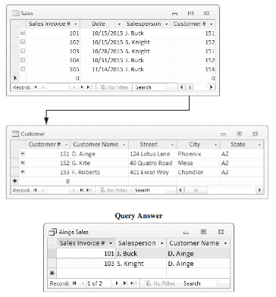
Microsoft Access Query #1

Slide 16
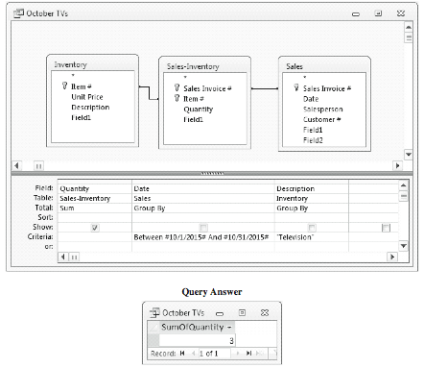
Microsoft Access Query #2

Slide 17
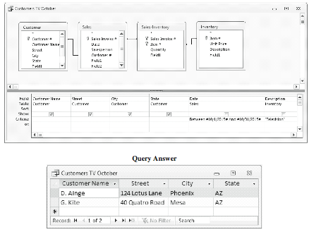
Microsoft Access Query #3

Slide 18
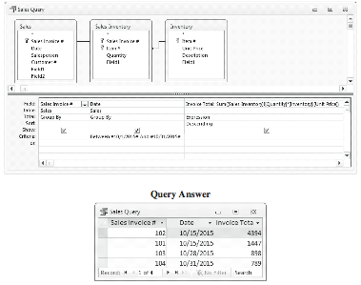
Microsoft Access Query #4

Slide 19
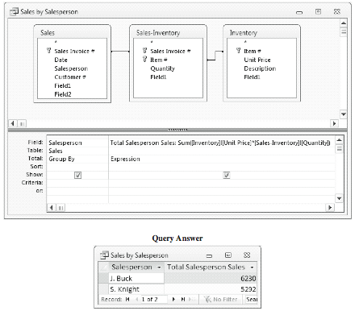
Microsoft Access Query #5

