Slide 1
Chapter 3
Systems Documentation Techniques

Slide 2
Learning Objectives
Prepare and use data flow diagrams to understand, evaluate, and document information systems.
Prepare and use flowcharts to understand, evaluate, and document information systems.
Questions to be addressed in this chapter include:
  What is the purpose of documentation?
  Why do accountants need to understand documentation?
  What documentation techniques are used in accounting systems?
  What are data flow diagrams and flowcharts?
    How are they alike and different?
    How are they prepared?

Slide 3
What Is Documentation?
Set of documents and models (type of tools)
  Narratives (written descriptions),
  data flow models,
  flowcharts
Documentation covers the following questions who, what, why, when, and where of systems:
  Input,
  process,
  storage,
  Output (information),
  and controls

Slide 4
Why accountants should learn documentation techniques?
How do accountants use documentation?
  At a minimum, they have to read documentation to understand how a system works.
  They may need to evaluate the strengths and weaknesses of an entity’s internal controls.
    Requires heavy reliance on documentation
  They may peruse documentation to determine if a proposed system meets the needs of its users.
  They may prepare documentation to:
    Demonstrate how a proposed system would work
    Demonstrate their understanding of a system of internal controls

Slide 5
Why Should You Learn Documentation?
You need to be able to read documentation in all its forms: narratives, diagrams, models.
You need to be able to evaluate the quality of systems, such as internal control based in part on documentation.
SAS 94 requires independent auditors to understand all internal control procedures.
  Documentation assists in auditor understanding and documentation of their understanding
Sarbanes-Oxley states that management:
  Is responsible for internal control system
  Is responsible for assessing the effectiveness of the IC System
  Both management and external auditors need to document and test IC System

Slide 6
Data flow diagrams and Flowcharts
In this chapter, we discuss two of the most common documentation tools:
Data flow diagrams: Graphical descriptions of the sources and destinations of data. They show:
  Where data comes from
  How it flows
  The processes performed on it
  Where it goes
Flowcharts: Include three types:
  Document flowcharts describe the flow of documents and information between departments or units. Useful for analyzing internal control procedures
  System flowcharts describe the relationship between inputs, processing, and outputs for a system. Useful in systems analysis and design
  Program flowcharts describe the sequence of logical operations performed in a computer program

Slide 7
DATA FLOW DIAGRAMS
Which method should you use—flowcharts or DVDs?
  62.5% of IS professionals use DFDs
  97.6% use flowcharts
  Both can be prepared relatively simply using available software
  Both are tested on professional exams
  CONCLUSION: You need to know them both
A data flow diagram (DFD) graphically describes the flow of data within an organization. It is used to:
  Document existing systems
  Plan and design new systems
There is no black-and-white approach to developing a DFD.

Slide 8
DATA FLOW DIAGRAMS
Example of a data flow diagram of the customer payment process
Accounts
Receivable
Customer
Customer
payment
1.0
Process
Payment
Remittance
data
2.0
Update
A/R
Receivables
Information
Credit
Manager
Deposit
Bank

Slide 9
DATA FLOW DIAGRAMS
A data flow diagram consists of four basic elements:
  Data sources and destinations
  Data flows
  Transformation processes
  Data stores

Slide 10
Data Flow Diagrams
Graphically describes the flow of data within a system
Four basic elements
Entity
Process
Data Flow
Data Store

Slide 11
DATA FLOW DIAGRAMS
Data sources and destinations
  Appear as squares
  Represent organizations or individuals that send or receive data used or produced by the system
An item can be both a source and a destination
Entity

Slide 12
DATA FLOW DIAGRAMS
Data flows
  Appear as arrows
  Represent the flow of data between sources and destinations, processes, and data stores
Data Flow

Slide 13
DATA FLOW DIAGRAMS
As you probably surmised from the previous slides, if a data flow is two-way, use a bi-directional arrow.
Update
Receiv-
ables
General
Ledger

Slide 14
DATA FLOW DIAGRAMS
If two data elements flow together, then the use of one data flow line is appropriate.
Process
Payment
Customer
Cash Rec’d & Remittance Slip

Slide 15
DATA FLOW DIAGRAMS
If the data elements do not always flow together, then multiple lines will be needed.
Process
Payment
Customer
Customer Inquiry
Customer Payment

Slide 16
DATA FLOW DIAGRAMS
Processes
  Appear as circles
  Represent the transformation of data
Process

Slide 17
DATA FLOW DIAGRAMS
Data stores
  Appear as two horizontal lines
  Represent a temporary or permanent repository of data
Data Store

Slide 18
DATA FLOW DIAGRAMS
Data dictionary:
  Data flows and data stores are typically collections of data elements.
  EXAMPLE: A data flow labeled student information might contain elements such as student name, date of birth, ID number, address, phone number, and major.
  The data dictionary contains a description of all data elements, data stores, and data flows in a system.

Slide 19
DATA FLOW DIAGRAMS
Subdividing the DFD:
  Few systems can be fully diagrammed on one sheet of paper, and users have needs for differing levels of detail.
  Consequently, DFDs are subdivided into successively lower levels to provide increasing amounts of detail.
The highest level of DFD is called a context diagram.
  It provides a summary-level view of the system.
  It depicts a data processing system and the external entities that are:
    Sources of its input
    Destinations of its output

Slide 20
DATA FLOW DIAGRAMS
Govt.
Agencies
Depart-
ments
Tax report & payment
Time cards
Payroll
Processing
System
Employees
Employee checks
New employee form
Payroll check
Bank
Human
Resources
Employee change form
Payroll report
This is the context diagram for the S&S payroll processing system (Figure 3-5 in your textbook).
Manage-
ment

Slide 21
DATA FLOW DIAGRAMS
Depart-
ments
Employees
Employee
paychecks
Human
Resources
New employee
form
Time
cards
1.0
Update
Empl.
Payroll
File
2.0
Pay
Employ-
ees
Employee
change
form
Payroll
check
Bank
Payroll
disburse-
ment data
3.0
Prepare
Reports
Employee/
Payroll File
5.0
Update
Gen.
Ledger
What information comes into these processes and from where?
Payroll tax
disb. voucher
Payroll
report
4.0
Pay
Taxes
General
Ledger
Manage-
ment
Tax report
& payment
Govt.
Agencies

Slide 22
DATA FLOW DIAGRAMS
But before we do, let’s step through some guidelines on how to create a DFD.
RULE 1: Understand the system. Observe the flow of information and interview people involved to gain that understanding.
RULE 2: Ignore control processes and control actions (e.g., error corrections). Only very critical error paths should be included.
RULE 3: Determine the system boundaries—where it starts and stops. If you’re not sure about a process, include it for the time being.
RULE 4: Draw the context diagram first, and then draw successively greater levels of detail.
RULE 5: Identify and label all data flows. The only ones that do not have to be labeled are those that go into or come out of data stores

Slide 23
DATA FLOW DIAGRAMS
RULE 6: Data flows that always flow together should be grouped together. Those that do not flow together should be shown on separate lines.
RULE 7: Show a process (circle) wherever a data flow is converted from one form to another. Likewise, every process should have at least one incoming data flow and at least one outgoing data flow.
RULE 8: Transformation processes that are logically related or occur simultaneously can be grouped in one bubble.
RULE 9: Number each process sequentially. A process labeled 5.0 would be exploded at the next level into processes numbered 5.1, 5.2, etc. A process labeled 5.2 would be exploded into 5.21, 5.22, etc.

Slide 24
DATA FLOW DIAGRAMS
RULE 10: Process names should include action verbs, such as update, prepare, etc.
RULE 11: Identify and label all data stores, whether temporary or permanent.
RULE 12: Identify and label all sources and destinations. An entity can be both a source and destination. You may wish to include such items twice on the diagram, if needed, to avoid excessive or crossing lines.
RULE 13: As much as possible, organize the flow from top to bottom and left to right.
RULE 14: You’re not likely to get it beautiful the first time, so plan to go through several iterations of refinements.
RULE 15: On the final copy, lines should not cross. On each page, include:
  The name of the DFD
  The date prepared
  The preparer’s name

Slide 25
DATA FLOW DIAGRAMS
Now that we’ve been through the guidelines for developing DFDs, let’s go back to the chapter example and see if we can re-create a part of it.
You may wish to create a table with the following headings to organize your information:
  Data Inputs
  Processes
  Data Outputs
The first paragraph of the narrative for the payroll process reads as follows:
  When employees are hired, they complete a new employee form. When a change to an employee’s payroll status occurs, such as a raise or a change in the number of exemptions, human resources completes an employee change form. A copy of these forms is sent to payroll. These forms are used to create or update the records in the employee/payroll file and are then stored in the file. Employee records are stored alphabetically.

Slide 26
DATA FLOW DIAGRAMS
Data Inputs | Processes | Data Outputs
New employee forms and employee change forms (from H.R. Dept.) | Update records (read from file and record) | Updated employee/ payroll file
We will not do the entire DFD, however, you could finish this table by reading the remainder of the narrative in Table 3-1 in your textbook. The portion of the table completed so far allows us to draw the segment of the DFD that is highlighted on the following slide.

Slide 27
DATA FLOW DIAGRAMS
Depart-
ments
Employees
Employee
paychecks
Human
Resources
New employee
form
Time
cards
1.0
Update
Empl.
Payroll
File
2.0
Pay
Employ-
ees
Employee
change
form
Payroll
check
Bank
Payroll
disburse-
ment data
3.0
Prepare
Reports
Employee/
Payroll File
5.0
Update
Gen.
Ledger
Payroll tax
disb. voucher
Payroll
report
4.0
Pay
Taxes
General
Ledger
Manage-
ment
Tax report
& payment
Govt.
Agencies

Slide 28
FLOWCHARTS
A flowchart is an analytical technique that describes some aspect of an information system in a clear, concise, and logical manner.
Flowcharts use a set of standard symbols to depict processing procedures and the flow of data.
Flowcharting History:
  Introduced in 1950s by industrial engineers to document business processes and document flows for process improvement.
  Sarbanes-Oxley 2002 increased importance by requiring companies to document business processes and internal controls procedures.

Slide 29
FLOWCHARTS
Every shape on a flowchart depicts a unique operation, input, processing activity, or storage medium.
Most flowcharts are now drawn using a software program such as Visio.
  Microsoft and Power Point are also used.
  The software uses pre-drawn shapes, and the developer drags the shapes into the drawing.

Slide 30
FLOWCHARTS
There are four types of flowcharting symbols:
  Input/output symbols
  Processing symbols
  Storage symbols
  Flow and miscellaneous symbols
Flow and miscellaneous symbols may indicate:
  The flow of data and goods
  The beginning or end of the flowchart
  The location of a decision
  An explanatory note

Slide 31
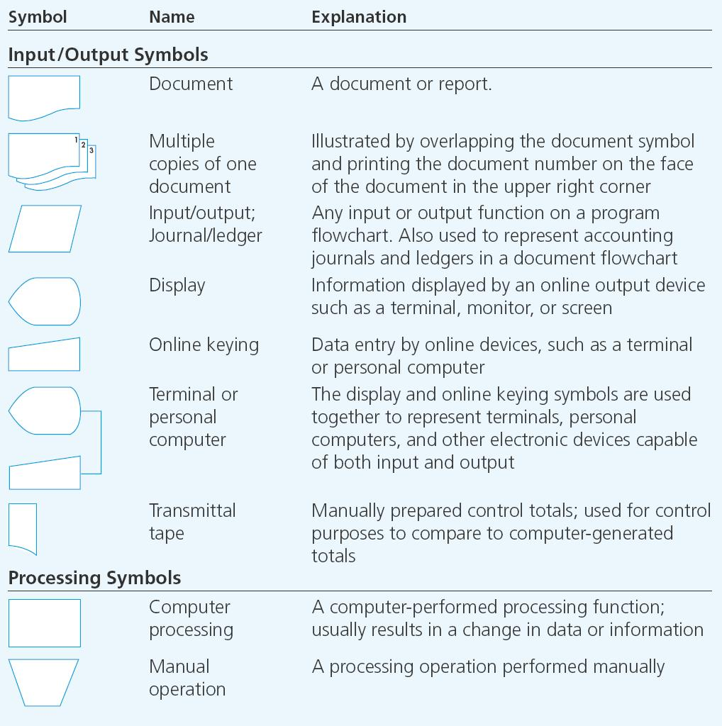
Flowchart Symbol Categories
Input/Output
Processing
Storage
Miscellaneous

Slide 32
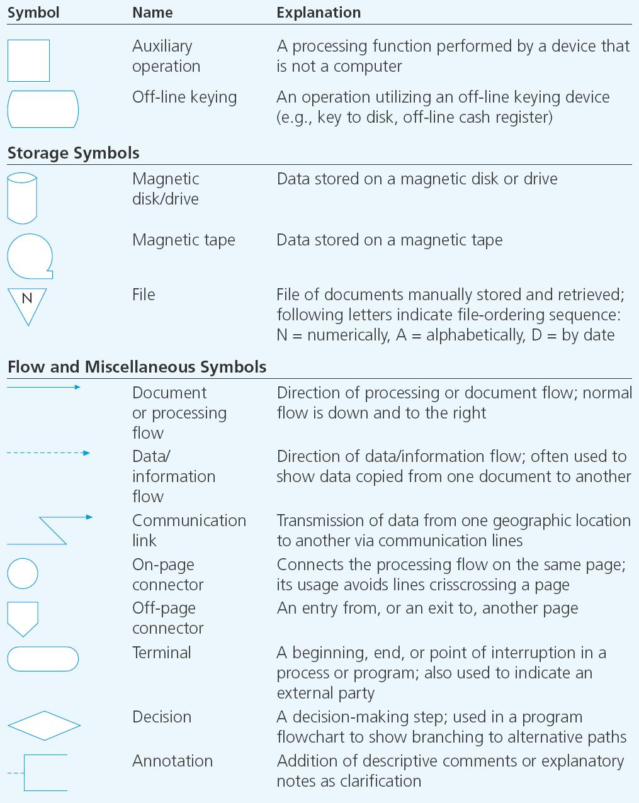
Flow Chart Symbol Categories

Slide 33
INPUT/OUTPUT SYMBOLS
Document Symbol
  Represents a document or report
  that is prepared by hand or printed by a computer
Multiple Copies of One Document
  Indicates multiple copies of a paper document or report.
  The document copies should be numbered in the upper, right-hand corner
2
3
1

Slide 34
PROCESSING SYMBOLS
Manual Operation
  Represents a processing operation that is performed manually.

Slide 35
STORAGE SYMBOLS
A
File
  Represents a file of documents that are manually stored and retrieved.
  Letter indicates the ordering sequence:
    A = Alphabetic order
    D = Date order
    N = Numeric order

Slide 36
FLOW AND MISCELLANEOUS SYMBOLS
Document or Processing Flow
  Represents the direction of processing or document flow.
  Normal flow is top to bottom and left to right.
Data/Information Flow
  Represents the direction of data/information flow.
  Often used to show data being copied from one document to another.

Slide 37
FLOW AND MISCELLANEOUS SYMBOLS
Communication Link
  Represents the transmission of data from one location to another via communication lines.

Slide 38
FLOW AND MISCELLANEOUS SYMBOLS
On-page connector
  Connects processing from one location to another on the same page.
  Used to avoid crisscrossing lines.
Off-page Connector
  Connects the processing flow between two different pages.
  Signals the exit from one page and the corresponding entrance on another page.

Slide 39
FLOW AND MISCELLANEOUS SYMBOLS
Terminal
  Represents the beginning, end, or a point of interruption in a process or program.
  Also used to indicate an external party.

Slide 40
FLOW AND MISCELLANEOUS SYMBOLS
Annotation
  Provides for the addition of descriptive comments or explanatory notes as clarification.

Slide 41
DOCUMENT FLOWCHARTS
A document flowchart shows the flow of documents and information among areas of responsibility in an organization.
These flowcharts trace a document from cradle to grave and show:
  Where a document comes from
  Where it’s distributed
  How it’s used
  It’s ultimate disposition
  Everything that happens as it flows through the system
Internal control flowcharts are document flowcharts used to evaluate the adequacy of internal controls, such as segregation of duties or internal checks.
They can reveal weaknesses or inefficiencies such as:
  Inadequate communication flows
  Unnecessarily complex document flows
  Procedures that cause wasteful delays
Document flowcharts are also prepared in the system design process.

Slide 42
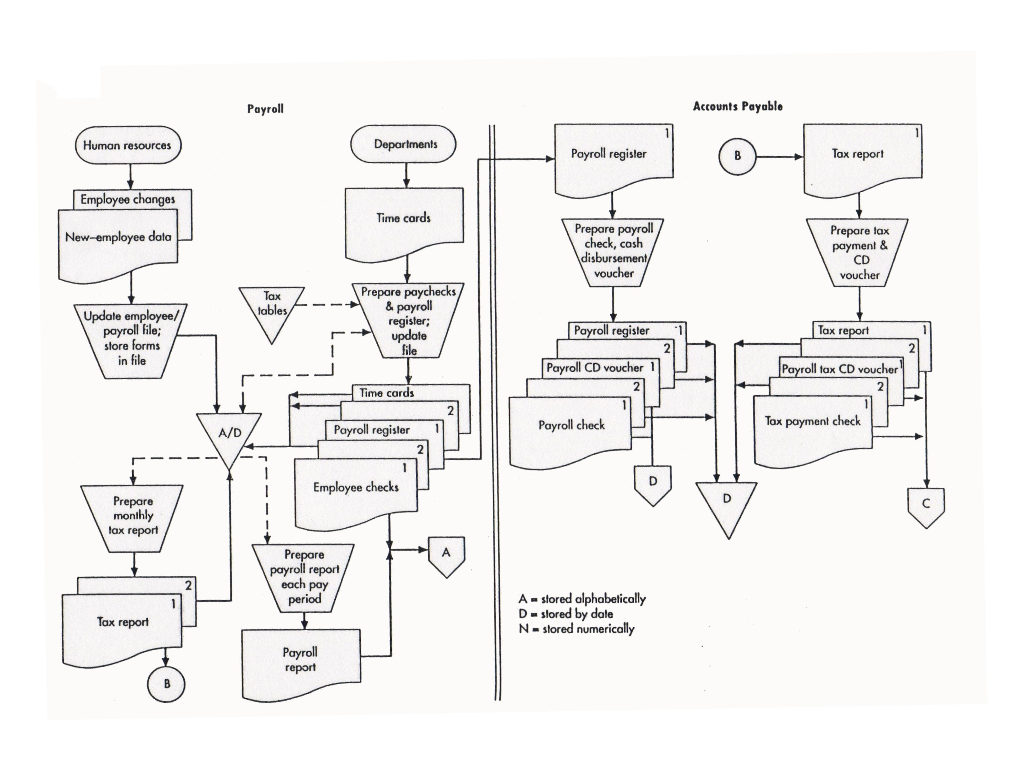

Slide 43
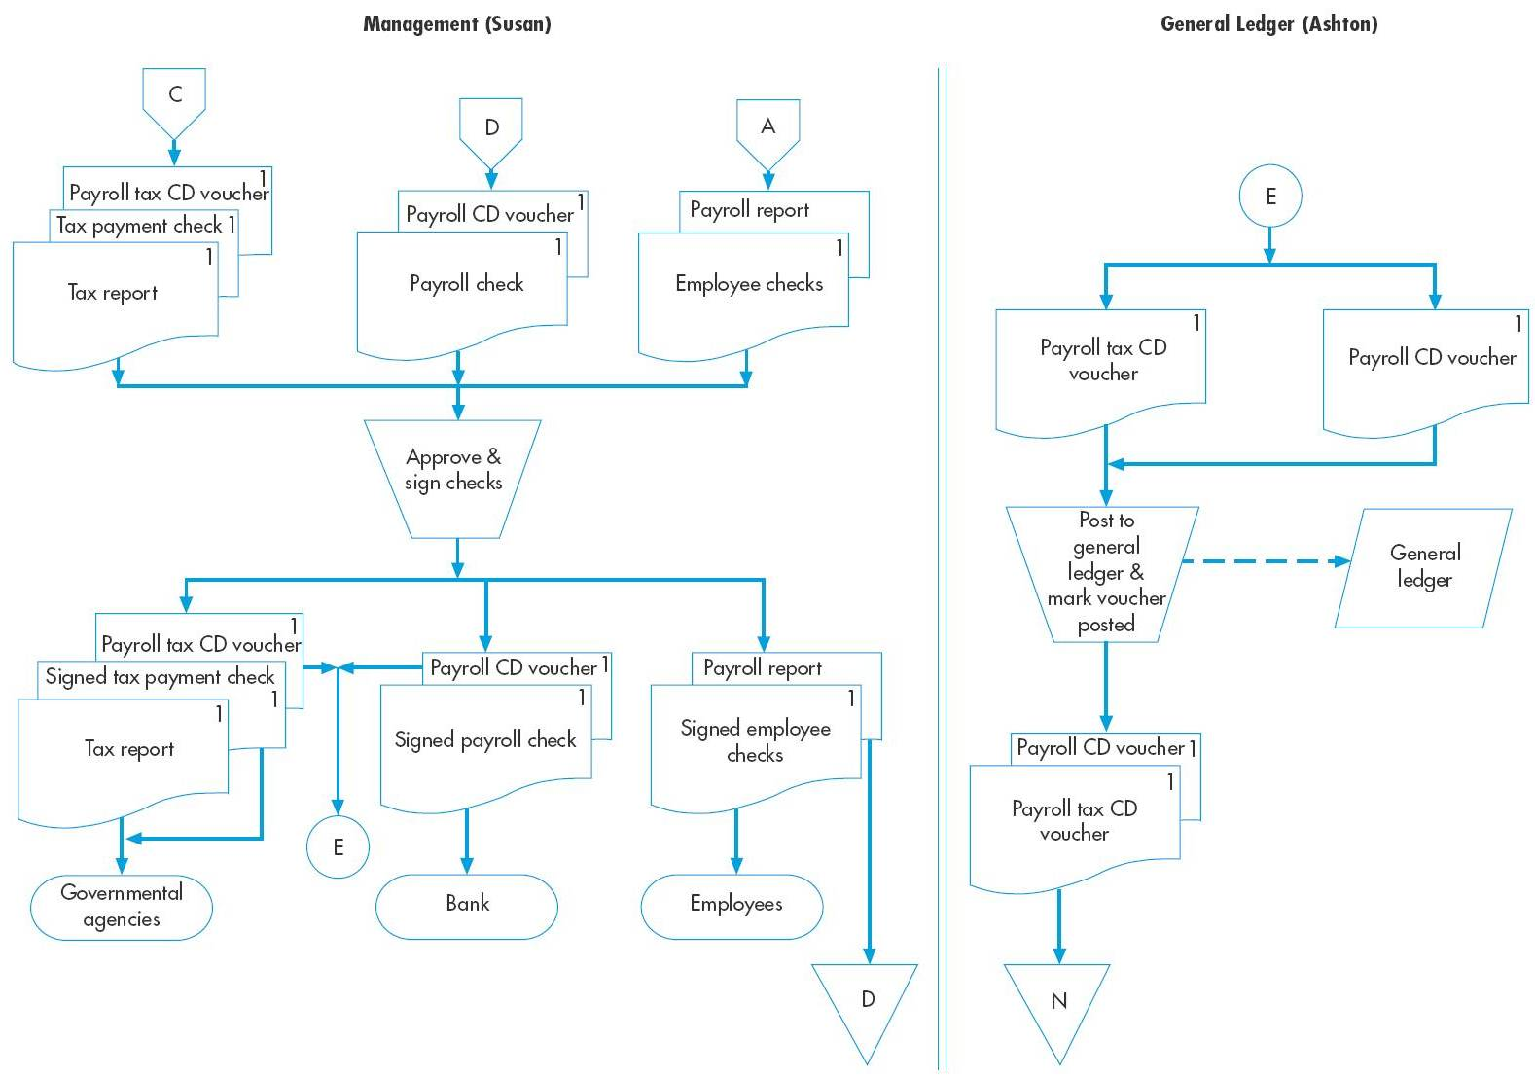
Document Flowchart (cont’d)
Copyright © 2012 Pearson Education, Inc. publishing as Prentice Hall
3-43

Slide 44
GUIDELINES FOR PREPARING FLOWCHARTS
Let’s step through some guidelines for preparing flowcharts:
  As with DFDs, you can’t effectively prepare a flowchart if you don’t understand the system, so:
    Interview users, developers, auditors, and management
    Administer questionnaires
    Read through narratives
    Walk through systems transactions
  Identify:
    Entities to be flowcharted, e.g., departments, functions, external parties (the parties who “do” things in the story)
    Documents or information flows
    Processes
  As you read through a narrative, you may want to mark the preceding items with different shapes (e.g., drawing a rectangle around entities, circling documents, etc.).
  Use separate columns for the activity of each entity.
    Example: If there are three different departments or functions that “do” things in the narrative, there would be three columns on the flowchart

Slide 45
What are the entities in this flowchart?

Slide 46
GUIDELINES FOR PREPARING FLOWCHARTS
  Flowchart the normal course of operations, and identify exceptions with annotations.
  As much as possible, the flow should go from top to bottom and left to right.
  Use standard flowcharting symbols, and draw with a template or computer.
  Clearly label all symbols. Use annotations if necessary to provide adequate explanation.
  Give the flowchart a clear beginning and ending.
    Show where each document originated and its final disposition.
  One approach you can use is to read through the narrative and for each step define:
    What was (were) the input(s)
    What process was carried out
    What was (were) the output(s)
  Note on the next slide that the flow sequence is input—process—output.

Slide 47
Identifies where input is coming from

Slide 48
Inputs

Slide 49
GUIDELINES FOR PREPARING FLOWCHARTS
  Every manual process should have at least one input and at least one output.
  Show all data entered into or retrieved from a computer file as passing through a process first.
  Do not show process symbols for:
    Forwarding a document to another entity
    Filing a document
  Do not connect two documents except when forwarding to another column.
    When a document is forwarded, show it in both locations
  When using multiple copies of a document, place document numbers in the upper, right-hand corner

Slide 50
Show forwarded document in both locations

Slide 51
GUIDELINES FOR PREPARING FLOWCHARTS
  Show on-page connectors and label them clearly to avoid excess flow lines.
  Use off-page connectors if the flow goes to another page.

Slide 52
Are there other off-page connectors on this flowchart?

Slide 53
Document Flowchart (cont’d)
Copyright © 2012 Pearson Education, Inc. publishing as Prentice Hall
3-53

Slide 54
GUIDELINES FOR PREPARING FLOWCHARTS
  If a flowchart takes more than one page, label the pages as 1 of 5, 2 of 5, 3 of 5, etc.
  Show documents or reports first in the column where they are created.
  Start with a rough draft; then redesign to avoid clutter and crossed lines.
  Verify the accuracy of your flowchart by reviewing it with users, etc.
  Place the flowchart name, the date, and the preparer’s name on each page of the final copy.

Slide 55
SYSTEM FLOWCHARTS
A system flowchart depicts the relationship among the inputs, processes, and outputs of an AIS.
  The system flowchart begins by identifying the inputs to the system. These data can be: New data , data store for future use, Both
  Each input is followed by a process, i.e., the steps performed on the data. If the process is performed by a computer, the logic of the computer program would be depicted in a program flowchart.
  The process is followed by outputs—the resulting new information. Stored for later use
  Displayed on a screen
  Printed on paper
  An input to the next process
  In other words, it’s the same basic input— process—output pattern that we saw in the document flowchart.

Slide 56
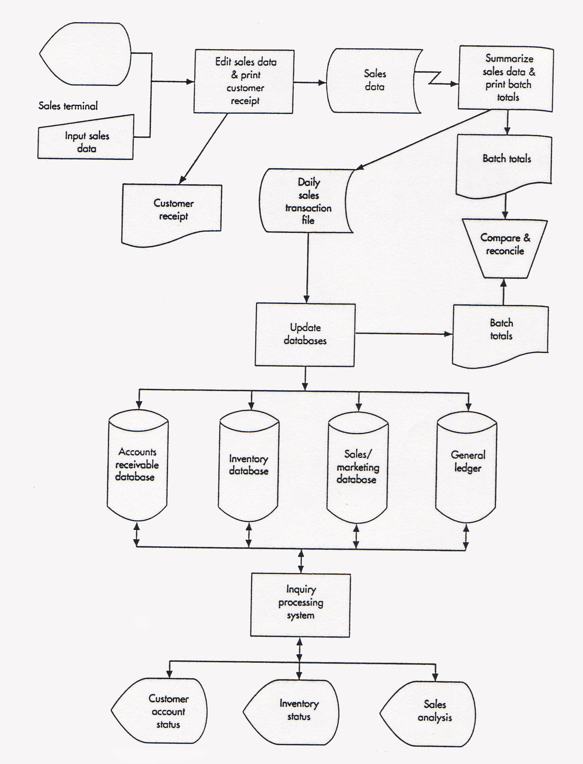
System Flowchart Shown in Figure 3-11 in your textbook
Can you spot the input— process—output pattern?

Slide 57
PROGRAM FLOWCHARTS
Program flowcharts illustrate the sequence of logical operations performed by a computer in executing a program.
They also follow an input—process— output pattern.

Slide 58
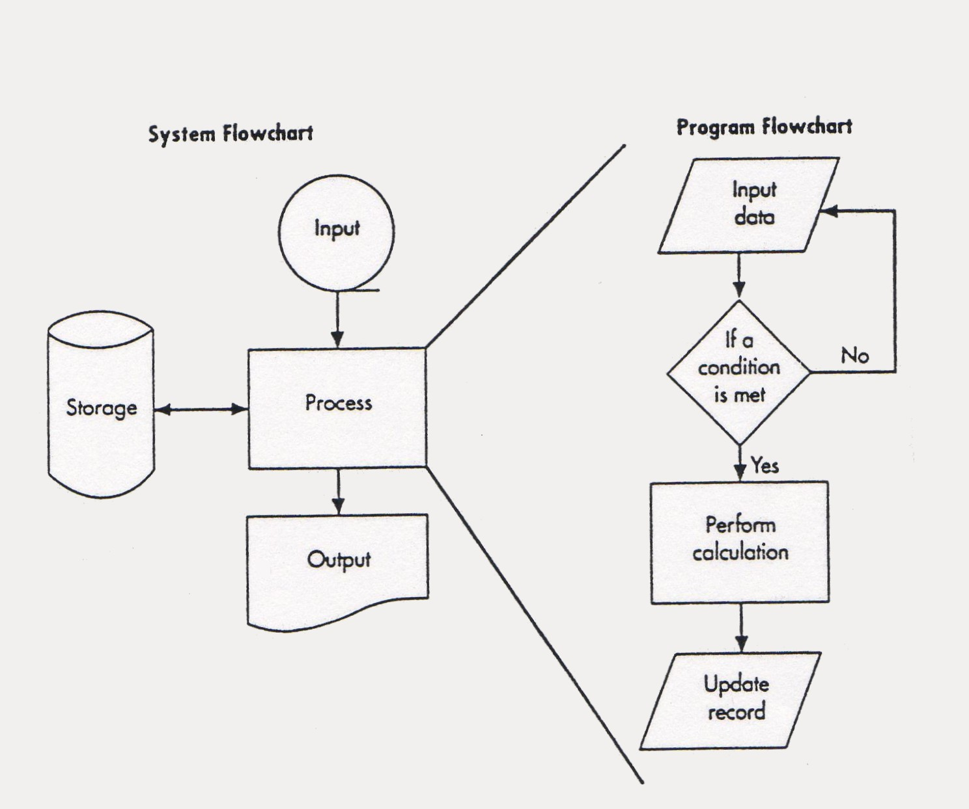
The program flowchart from Figure 3-11 in your textbook is shown on the right.

Slide 59
FLOWCHARTS VS. DFDs
Now that we’ve examined both flowcharts and DFDs, it may be useful to discuss the differences again.
DFDs place a heavy emphasis on the logical aspects of a system.
Flowcharts place more emphasis on the physical characteristics of the system.
An example may be useful.
EXAMPLE: The registrar’s office of a small college receives paper enrollment forms from students. They sort these records alphabetically and then update the student record file to show the new classes. They also prepare class lists from the same data. The sorted enrollment forms are forwarded to the bursar’s office for billing purposes. Class lists are mailed to faculty members

Slide 60
Registrar’s Office
Students
Students
Enrollment
Forms
Sort
Forms
Enrollment
Forms
1.0
Update
Student
Records
A
Update
Student
Records
Sorted
Enrollment
Forms
Student
Records
Enrollment
Forms
Sorted
Enrollment
Forms
Prepare
Class
Lists
2.0
Prepare
Class Lists
Bursar
Here’s a flowchart that goes with the story
Enrollment
Forms
Class
Lists
Sorted
Enrollment
Forms
Class
Lists
Faculty
Faculty
Bursar

Slide 61
FLOWCHARTS VS. DFDs
Now let’s change the story so that students enter enrollment data online. The registrar’s office sends a tape file of the enrollment data to the bursar’s office and continues to send paper class lists to faculty.

Slide 62
Here’s the revised DFD. How has it changed?
Original DFD
Students
Students
Enrollment
Forms
Enrollment
Data
1.0
Update
Student
Records
1.0
Update
Student
Records
Student
Records
Student
Records
Enrollment
Forms
Enrollment
Data
2.0
Prepare
Class Lists
2.0
Prepare
Class Lists
Bursar
Bursar
Enrollment
Forms
Enrollment
Data
Class
Lists
Class
Lists
Faculty
Faculty

Slide 63
Registrar’s Office
Registrar’s Office
Students
Enrollment
Forms
Sort
Forms
Students
Enrollment
Data
Update
Student
Records
Sorted
Enrollment
Forms
Enrollment
Data
Update
Student
Records
A
Sorted
Enrollment
Forms
Prepare
Class
Lists
Bursar
Student
Records
Prepare
Class
Lists
Class
Lists
Sorted
Enrollment
Forms
Here’s the revised flowchart. How has it changed?
Class
Lists
Faculty
Bursar
Faculty
Original Flowchart

Slide 64

QUIZ QUESTION
How is playing the piano like making DFDs and flowcharts?
  You can’t learn to do it by just watching someone else.
  You can’t learn to do it by just looking at examples.
  Your first attempts are clumsy.
  Practice leads to improvement and maybe even perfection.

