Slide 1
Chapter 13
The Expenditure Cycle: Purchasing to Cash Disbursements

Slide 2
Learning Objectives
Explain the basic business activities and related information processing operations performed in the expenditure cycle.
Discuss the key decisions to be made in the expenditure cycle, and identify the information needed to make those decisions.
Identify major threats in the expenditure cycle, and evaluate the adequacy of various control procedures for dealing with those threats.

Slide 3
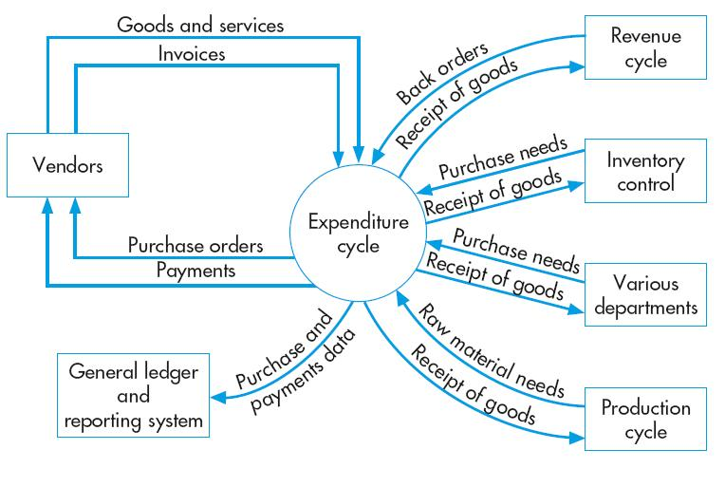
The Expenditure Cycle

Slide 4
The Expenditure Cycle
Activities and information processing related to:
  Purchasing and payment of
    Goods and services
Primary objective:
  Minimize the total cost of acquiring and maintaining inventories, supplies, and the various services the organization needs to function

Slide 5
The Expenditure Cycle
The primary external exchange of information is with suppliers (vendors).
Information flows to the expenditure cycle from other cycles, e.g.:
  The revenue cycle, production cycle, inventory control, and various departments provide information about the need to purchase goods and materials.
Information also flows from the expenditure cycle:
  When the goods and materials arrive, the expenditure cycle provides information about their receipt to the parties that have requested them.
  Information is provided to the general ledger and reporting function for internal and external financial reporting.

Slide 6
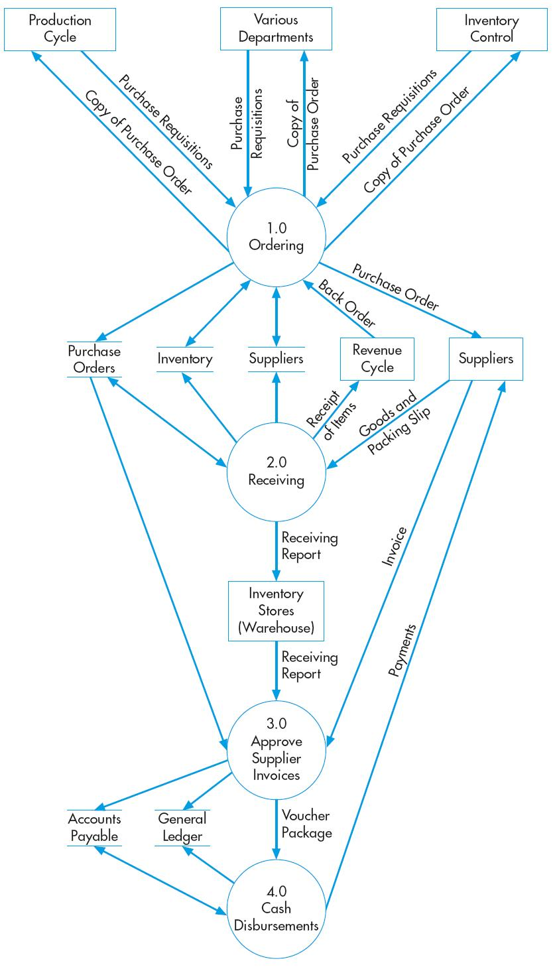
Expenditure Cycle Activities
There are four activities
Ordering materials, supplies, and services
Receiving materials, supplies, and services
Approving supplier invoices
Cash disbursements
These activities mirror the activities in the revenue cycle.

Slide 7
Expenditure Cycle General Threats
Inaccurate or invalid master data
Unauthorized disclosure of sensitive information
Loss or destruction of data
Poor performance

Slide 8
Expenditure Cycle General Controls
Data processing integrity controls
Restriction of access to master data
Review of all changes to master data

Slide 9
Ordering materials, supplies, and services
Key decisions in this process involve identifying what, when, and how much to purchase and from whom.
Weaknesses in inventory control can create significant problems with this process:
  Inaccurate records cause shortages.
One of the key factors affecting this process is the inventory control method to be used
Alternate inventory control methods
  We will consider three alternate approaches to inventory control:
    Economic Order Quantity (EOQ)
    Just in Time Inventory (JIT)
    Materials Requirements Planning (MRP)

Slide 10
PARTIAL ORGANIZATION CHART FOR UNITS INVOLVED IN EXPENDITURE CYCLE
Selects suitable suppliers
Issues purchase orders

Slide 11
Ordering materials, supplies, and services
EOQ is the traditional approach to managing inventory.
  Goal: Maintain enough stock so that production doesn’t get interrupted.
  Under this approach, an optimal order size is calculated by minimizing the sum of several costs:
    Ordering costs
    Carrying costs
    Stockout costs
  The EOQ formula is also used to calculate reorder point, i.e., the inventory level at which a new order should be placed.
  Other, more recent approaches try to minimize or eliminate the amount of inventory carried.

Slide 12
Ordering materials, supplies, and services
MRP seeks to reduce inventory levels by improving the accuracy of forecasting techniques and carefully scheduling production and purchasing around that forecast.
JIT systems attempt to minimize or eliminate inventory by purchasing or producing only in response to actual (as opposed to forecasted) sales.
These systems have frequent, small deliveries of materials, parts, and supplies directly to the location where production will occur.

Slide 13
Ordering materials, supplies, and services
The need to purchase goods typically results in the creation of a purchase requisition. The purchase requisition is a paper document or electronic form that identifies:
  Who is requesting the goods
  Where they should be delivered
  When they’re needed
  Item numbers, descriptions, quantities, and prices
  Possibly a suggested supplier
  Department number and account number to be charged
Most of the detail on the suppliers and the items purchased can be pulled from the supplier and inventory master files.

Slide 14
Ordering materials, supplies, and services
The purchase requisition is received by a purchasing agent (aka, buyer) in the purchasing department, who typically performs the purchasing activity.
  In manufacturing companies, this function usually reports to the VP of Manufacturing.
A crucial decision is the selection of supplier.
Key considerations are:
  Price
  Quality
  Dependability
    Especially important in JIT systems because late or defective deliveries can bring the whole system to a halt.
    Consequently, certification that suppliers meet ISO 9000 quality standards is important. This certification recognizes that the supplier has adequate quality control processes.

Slide 15
Ordering materials, supplies, and services
Once a supplier has been selected for a product, their identity should become part of the product inventory master file so that the selection process does not have to be carried out for every purchase.
  A list of potential alternates should also be maintained.
  For products that are seldom ordered, the selection process may be repeated every time
It’s important to track and periodically evaluate supplier performance, including data on:
  Purchase prices
  Rework and scrap costs
  Supplier delivery performance
The purchasing function should be evaluated and rewarded based on how well it minimizes total costs, not just the costs of purchasing the goods.

Slide 16
Ordering materials, supplies, and services
A purchase order is a document or electronic form that formally requests a supplier to sell and deliver specified products at specified prices.
The PO is both a contract and a promise to pay. It includes:
  Names of supplier and purchasing agent
  Order and requested delivery dates
  Delivery location
  Shipping method
  Details of the items ordered

Slide 17
Ordering materials, supplies, and services
IT can help improve efficiency and effectiveness of purchasing function.
  The major cost driver is the number of purchase orders processed. Time and cost can be cut by:
    Using EDI to transmit purchase orders.
    Using vendor-managed inventory systems.
    Reverse auctions.
    Pre-award audits

Slide 18
Ordering Threats
Inaccurate inventory records
Purchasing items not needed
Purchasing at inflated prices
Purchasing goods of inferior quality
Unreliable suppliers
Purchasing from unauthorized suppliers
Kickbacks

Slide 19
Ordering Threats
THREAT NO. 6—Kickbacks
  Why is this a problem?
    Kickbacks are gifts from suppliers to purchasing agents for the purpose of influencing their choice of suppliers. They typically result in many of the preceding threats, including:
      Paying inflated prices.
      Buying unneeded items.
      Buying goods of inferior quality.
Copyright © 2012 Pearson Education, Inc. publishing as Prentice Hall
13-19

Slide 20
Ordering Controls
Perpetual inventory system
Bar coding or RFID tags
Periodic physical counts of inventory
Perpetual inventory system
Review and approval of purchase requisitions
Centralized purchasing function
Price lists
Competitive bidding
Review of purchase orders
Budgets
Purchasing only from approved suppliers

Slide 21
Ordering Controls (cont’d)
Review and approval of purchases from new suppliers
Holding purchasing managers responsible for rework and scrap costs
Tracking and monitoring product quality by supplier
Requiring suppliers to possess quality certification (e.g., ISO 9000)
Collecting and monitoring supplier delivery performance data
Maintaining a list of approved suppliers and configuring the system to permit purchase orders only to approved suppliers
Review and approval of purchases from new suppliers
EDI-specific controls (access, review of orders, encryption, policy)
Requiring purchasing agents to disclose financial and personal interests in suppliers
Training employees in how to respond to offers of gifts from suppliers
Job rotation and mandatory vacations
Supplier audits
Copyright © 2012 Pearson Education, Inc. publishing as Prentice Hall
13-21

Slide 22
RECEIVING AND STORING GOODS
The receiving department accepts deliveries from suppliers.
  Normally, reports to warehouse manager, who reports to VP of Manufacturing.
Inventory stores typically stores the goods.
  Also reports to warehouse manager.
The receipt of goods must be communicated to the inventory control function to update inventory records.

Slide 23
PARTIAL ORGANIZATION CHART FOR UNITS INVOLVED IN EXPENDITURE CYCLE
Decides whether to accept deliveries
Counts and inspects deliveries

Slide 24
RECEIVING AND STORING GOODS
The two major responsibilities of the receiving department are:
  Deciding whether to accept delivery.
  Verifying the quantity and quality of delivered goods.
The first decision is based on whether there is a valid purchase order.
  Accepting un-ordered goods wastes time, handling and storage.
Verifying the quantity of delivered goods is important so:
  The company only pays for goods received.
  Inventory records are updated accurately.

Slide 25
RECEIVING AND STORING GOODS
The receiving report is the primary document used in this process:
  It documents the date goods received, shipper, supplier, and PO number.
  Shows item number, description, unit of measure, and quantity for each item.
  Provides space for signature and comments by the person who received and inspected.
When goods arrive, a receiving clerk compares the PO number on the packing slip with the open PO file to verify the goods were ordered.
  Then counts the goods.
  Examines for damage before routing to warehouse or factory.
Three possible exceptions in this process:
  The quantity of goods is different from the amount ordered;
  The goods are damaged; and
  The goods are of inferior quality

Slide 26
RECEIVING AND STORING GOODS
If one of these exceptions occurs, the purchasing agent resolves the situation with the supplier.
  Supplier typically allows adjustment to the invoice for quantity discrepancies.
  If goods are damaged or inferior, a debit memo is prepared after the supplier agrees to accept a return or grant a discount.
    One copy goes to supplier, who returns a credit memo in acknowledgment.
    One copy to accounts payable to adjust the account payable.
    One copy to shipping to be returned to supplier with the actual goods.
Copyright © 2012 Pearson Education, Inc. publishing as Prentice Hall
13-26

Slide 27
RECEIVING AND STORING GOODS
IT can help improve the efficiency and effectiveness of the receiving activity:
  Bar-coding
  RFID : Radio frequent identification
  EDI and satellite technology
  Audits
Audits can identify opportunities to cut freight costs and can ensure that suppliers are not billing for transportation costs they are supposed to assume.
Copyright © 2012 Pearson Education, Inc. publishing as Prentice Hall
13-27

Slide 28
Receiving Threats
Accepting unordered items
Mistakes in counting
Verifying receipt of services
Theft of inventory

Slide 29
Receiving Controls
Requiring existence of approved purchase order prior to accepting any delivery
Do not inform receiving employees about quantity ordered
Require receiving employees to sign receiving report
Incentives
Document transfer of goods to inventory
Use of bar-codes and RFID tags
Configuration of the ERP system to flag discrepancies between received and ordered quantities that exceed tolerance threshold for investigation
Segregation of duties: custody of inventory versus receiving
Budgetary controls
Audits
Restriction of physical access to inventory
Documentation of all transfers of inventory between receiving and inventory employees
Periodic physical counts of inventory and reconciliation to recorded quantities

Slide 30
Invoice Processing: Approving supplier invoices
There are two basic sub-processes involved in the payment process:
  Approval of vendor invoices
  Actual payment of the invoices
Approval of vendor invoices is done by the accounts payable department, which reports to the controller.
The legal obligation to pay arises when goods are received.
  But most companies pay only after receiving and approving the invoice.
  This timing difference may necessitate adjusting entries at the end of a fiscal period.
Copyright © 2012 Pearson Education, Inc. publishing as Prentice Hall
13-30

Slide 31
PARTIAL ORGANIZATION CHART FOR UNITS INVOLVED IN EXPENDITURE CYCLE
Approves invoices for payment
Copyright © 2012 Pearson Education, Inc. publishing as Prentice Hall
13-31

Slide 32
Invoice Processing
Objective of accounts payable:
  Authorize payment only for goods and services that were ordered and actually received.
Requires information from:
  Purchasing—about existence of valid purchase order.
  Receiving—for receiving report indicating goods were received
There are two basic approaches to processing vendor invoices:
  Non-voucher system
  Voucher system
Copyright © 2012 Pearson Education, Inc. publishing as Prentice Hall
13-32

Slide 33
Invoice Processing
Non-Voucher system
  Each approved invoice is posted to individual supplier records in the accounts payable file and is then stored in an open-invoice file.
  When a check is written to pay for an invoice, the voucher package is removed from the open-invoice file, the invoice is marked paid, and then the voucher package is stored in the paid-invoice file.
Voucher System
  Disbursement voucher is also created when a supplier invoice is approved for payment.
    Identifies the supplier, lists the outstanding invoices, and indicates the net amount to be paid after deducting any applicable discounts and allowances.

Slide 34
Invoice Processing
Advantages of a voucher system:
  Several invoices may be paid at once, which reduces number of checks written.
  Vouchers can be pre-numbered which simplifies the audit trail for payables.
  Invoice approval is separated from invoice payment, which makes it easier to schedule both to maximize efficiency.

Slide 35
Approving Invoices Threats
Errors in supplier invoices
Mistakes in posting to accounts payable

Slide 36
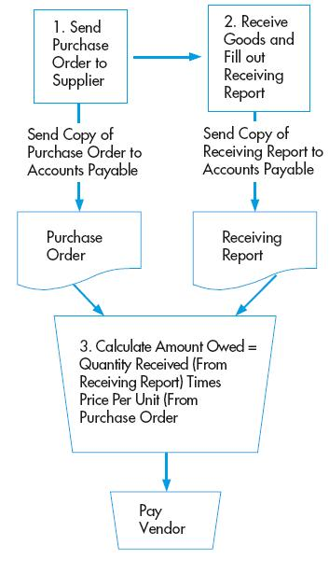
Approving Invoices Controls
Verification of invoice accuracy
Requiring detailed receipts for procurement card purchases
Evaluated receipt settlement
  Match PO with receiving report
Restriction of access to supplier master data
Verification of freight bill and use of approved delivery channels
Data entry edit controls
Reconciliation of detailed accounts payable records with the general ledger control account

Slide 37
Cash Disbursement Threats
Actual payment of the invoices
Payment of the invoices is done by the cashier, who reports to the treasurer.
The cashier receives a voucher package, which consists of the vendor invoice and supporting documentation, such as purchase order and receiving report.
This voucher package authorizes issuance of a check or EFT to the supplier.
Copyright © 2012 Pearson Education, Inc. publishing as Prentice Hall
13-37

Slide 38
PARTIAL ORGANIZATION CHART FOR UNITS INVOLVED IN EXPENDITURE CYCLE
Issues payment to vendors
Copyright © 2012 Pearson Education, Inc. publishing as Prentice Hall
13-38

Slide 39
Cash Disbursement Threats
Processing efficiency can be improved by:
  Requiring suppliers to submit invoices by EDI.
  Having the system automatically match invoices to POs and receiving reports.
  Eliminating vendor invoices.
  Using procurement cards for non-inventory purchases.
  Using company credit cards and electronic forms for travel expenses.
  Preparing careful cash budgets to take advantage of early-payment discounts.
  Using FEDI to pay suppliers.
Copyright © 2012 Pearson Education, Inc. publishing as Prentice Hall
13-39

Slide 40
Cash Disbursement Threats
Failure to take advantage of discounts for prompt payment
Paying for items not received
Duplicate payments
Theft of cash
Check alteration
Cash flow problems

Slide 41
Cash Disbursement Controls
Filing of invoices by due date for discounts
Cash flow budgets
Requiring that all supplier invoices be matched to supporting documents that are acknowledged by both receiving and inventory control
Budgets (for services)
Requiring receipts for travel expenses
Use of corporate credit cards for travel expenses
Requiring a complete voucher package for all payments
Policy to pay only from original copies of supplier invoices
Cancelling all supporting documents when payment is made

Slide 42
Cash Disbursement Controls
Cancelling all supporting documents when payment is made
Physical security of blank checks and check-signing machine
Periodic accounting of all sequentially numbered checks by cashier
Access controls to EFT terminals
Use of dedicated computer and browser for online banking
ACH blocks on accounts not used for payments
Separation of check-writing function from accounts payable
Requiring dual signatures on checks greater than a specific amount
Regular reconciliation of bank account with recorded amounts by someone independent of cash disbursements procedures

Slide 43
Cash Disbursement Controls
Restriction of access to supplier master file
Limiting the number of employees with ability to create one-time suppliers and to process invoices from one-time suppliers
Running petty cash as an imprest fund
Surprise audits of petty cash fund
Check protection machines
Use of special inks and papers
“Positive pay” arrangements with banks
Cash flow budget

