Slide 1
Chapter 12
The Revenue Cycle: Sales to Cash Collections

Slide 2
Learning Objectives
Describe the basic business activities and related information processing operations performed in the revenue cycle.
Discuss the key decisions that need to be made in the revenue cycle, and identify the information needed to make those decisions.
Identify major threats in the revenue cycle, and evaluate the adequacy of various control procedures for dealing with those threats.

Slide 3
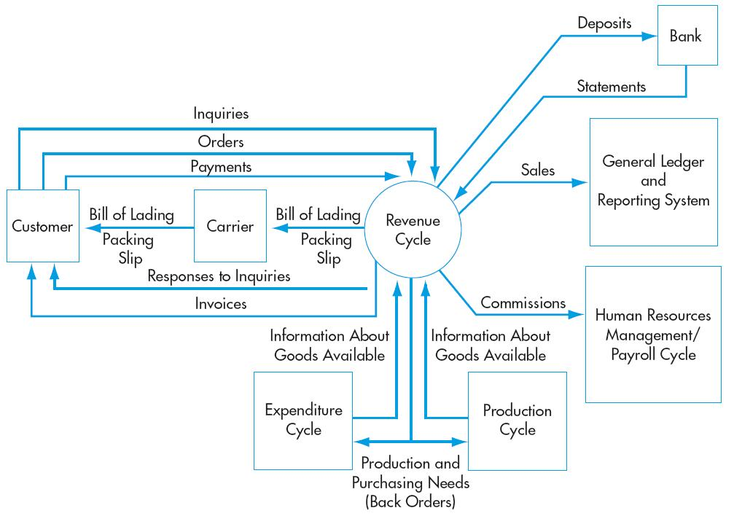
The Revenue Cycle
Copyright © 2012 Pearson Education, Inc. publishing as Prentice Hall
12-3

Slide 4
The Revenue Cycle
Provides goods and services to customers
Collects cash in payment for those sales
Primary Objective:
  Provide the right product
  In the right place
  At the right time for the right price
The primary external exchange of information is with customers
Copyright © 2012 Pearson Education, Inc. publishing as Prentice Hall
12-4

Slide 5
The Revenue Cycle
Information about revenue cycle activities flows to other accounting cycles, e.g.:
  The expenditure and production cycles
  Receive information about sales transactions so they’ll know 5when to initiate the purchase or production of more inventory.
  The human resources/payroll cycle
  Uses information about sales to calculate commissions and bonuses
  The general ledger and reporting function
  Uses information produced by the revenue cycle in preparing financial statements and performance reports

Slide 6
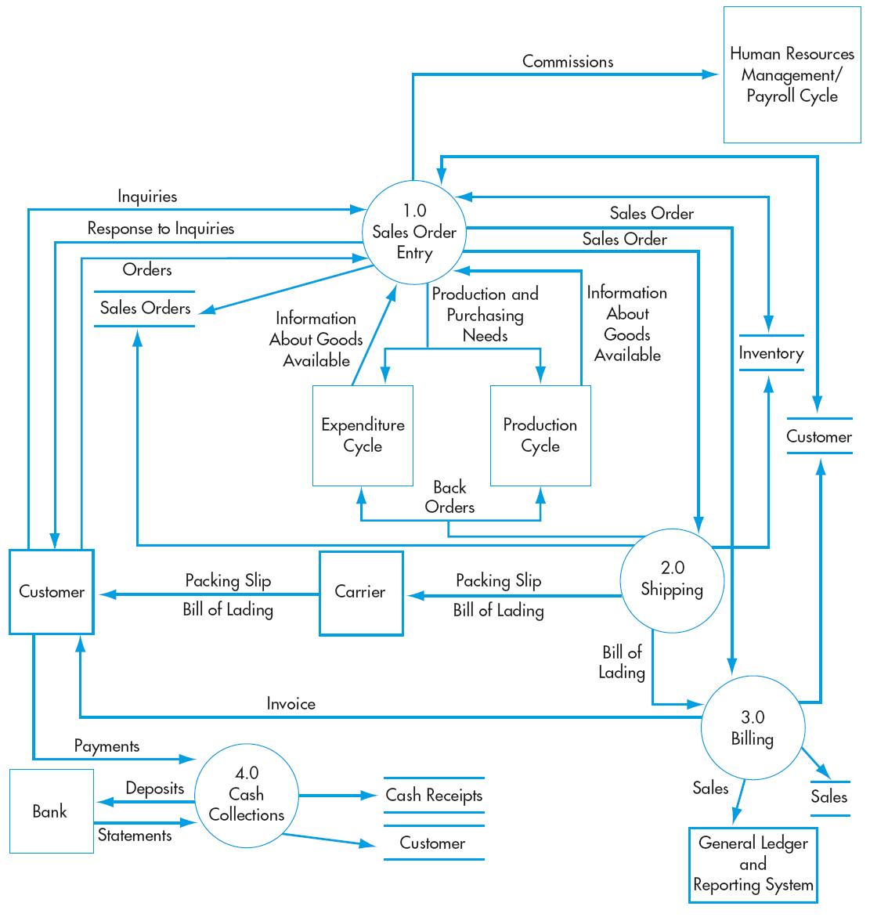
Revenue Cycle Activities
Sales order entry
Shipping
Billing
Cash collections
Copyright © 2012 Pearson Education, Inc. publishing as Prentice Hall
12-6

Slide 7
General Revenue Cycle Threats
Inaccurate or invalid master data
Unauthorized disclosure of sensitive information
Loss or destruction of master data
Poor performance
Copyright © 2012 Pearson Education, Inc. publishing as Prentice Hall
12-7

Slide 8
General Revenue Cycle Controls
Data processing integrity controls
Restriction of access to master data
Review of all changes to master data
Access controls
Encryption
Backup and disaster recovery procedures
Managerial reports
Copyright © 2012 Pearson Education, Inc. publishing as Prentice Hall
12-8

Slide 9
SALES ORDER ENTRY
Sales order entry is performed by the sales order department.
The sales order department typically reports to the VP of Marketing.
Steps in the sales order entry process include:
  Take the customer’s order.
  Check the customer’s credit.
  Check inventory availability.
  Respond to customer inquiries (may be done by customer service or sales order entry).
Copyright © 2012 Pearson Education, Inc. publishing as Prentice Hall
12-9

Slide 10
PARTIAL ORGANIZATION CHART FOR UNITS INVOLVED IN REVENUE CYCLE

Slide 11
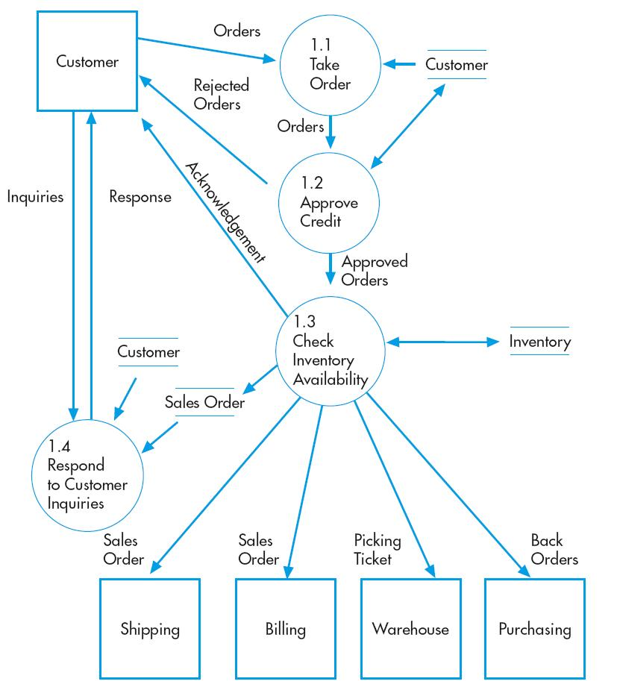
Sales Order Entry
Take order
Check and approve credit
Check inventory availability
Copyright © 2012 Pearson Education, Inc. publishing as Prentice Hall
12-11

Slide 12
SALES ORDER ENTRY
Take customer orders
  Order data are received on a sales order document which may be completed and received:
    In the store
    By mail
    By phone
    On a Website
    By a salesperson in the field
The sales order (paper or electronic) indicates:
  Item numbers ordered
  Quantities
  Prices
  Salesperson

Slide 13
SALES ORDER ENTRY
How IT can improve efficiency and effectiveness:
  Orders entered online can be routed directly to the warehouse for picking and shipping.
  Sales history can be used to customize solicitations.
  Choiceboards can be used to customize orders.

Slide 14
Sales Order Entry
Check the customer’s credit
Credit sales should be approved before the order is processed any further.
There are two types of credit authorization:
  General authorization
  Specific authorization

Slide 15
Sales order Entry
There are two types of credit authorization:
  General authorization
For existing customers below their credit limit who don’t have past- due balances.
Credit limits vary by customer based on past history and ability to pay.
General authorization involves checking the customer master file to verify the account and status.
  Specific authorization
For customers who are: New, Have past-due balances , Are placing orders that would exceed their credit limit
Specific authorization is done by the credit manager, who reports to the treasurer

Slide 16
Sales Order Entry
Check inventory availability
When the order has been received and the customer’s credit approved, the next step is to ensure there is sufficient inventory to fill the order and advise the customer of the delivery date.
The sales order clerk can usually reference a screen displaying:
  Quantity on hand
  Quantity already committed to others
  Quantity on order

Slide 17
Sales Order Entry
If there are enough units to fill the order:
  Complete the sales order.
  Update the quantity available field in the inventory file.
  Notify the following departments of the sale:
    Shipping
    Inventory
    Billing
  Send an acknowledgment to the customer.
If there’s not enough to fill the order, initiate a back order.
  For manufacturing companies, notify the production department that more should be manufactured.
  For retail companies, notify purchasing that more should be purchased

Slide 18
Sales Order Entry
Respond to customer inquiries (may be done by customer service or sales order entry).
Another step in the sales order entry process is responding to customer inquiries:
  May occur before or after the order is placed.
  The quality of this customer service can be critical to company success
Many companies use Customer Relationship Management (CRM) systems to support this process:
  Organizes customer data to facilitate efficient and personalized service.
  Provides data about customer needs and business practices so they can be contacted proactively about the need to reorder.

Slide 19
Sales Order Entry
The effectiveness of a website depends on its design:
  Review records of customer interactions to identify potential problems.
  A poorly-designed, difficult-to-use website can create customer ill will.
  A well-designed site can provide insights that lead to increased sales, e.g., by analyzing website traffic to determine products of greatest interest.

Slide 20
Sales Order Threats
Incomplete/inaccurate orders
Invalid orders
Uncollectible accounts
Stockouts or excess inventory
Loss of customers
Copyright 2012 © Pearson Education, Inc. publishing as Prentice Hall
12-20

Slide 21
Sales Order Entry Controls
Data entry edit controls (see Chapter 10)
Restriction of access to master data
Digital signatures or written signatures
Credit limits
Specific authorization to approve sales to new customers or sales that exceed a customer’s credit limit
Aging of accounts receivable
Perpetual inventory control system
Use of bar-codes or RFID
Training
Periodic physical counts of inventory
Sales forecasts and activity reports
CRM systems, self-help Web sites, and proper evaluation of customer service ratings
Copyright © 2012 Pearson Education, Inc. publishing as Prentice Hall
12-21

Slide 22
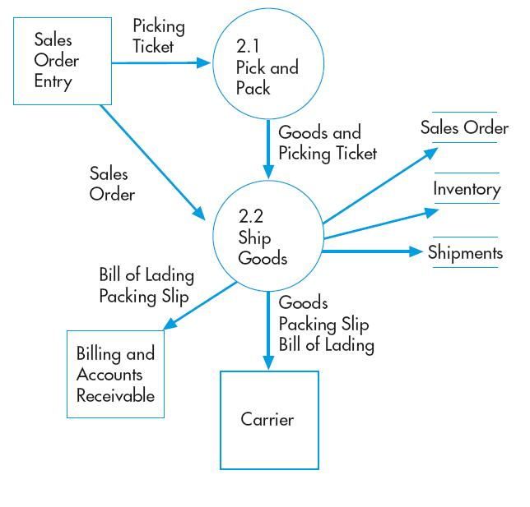
Shipping
Picking and packing the order
Shipping the order
Copyright © 2012 Pearson Education, Inc. publishing as Prentice Hall
12-22

Slide 23
Shipping
The second basic activity in the revenue cycle is filling customer orders and shipping the desired merchandise.
The process consists of two steps
  Picking and packing the order
  Shipping the order
The warehouse department typically picks the order
The shipping departments packs and ships the order
Both functions include custody of inventory and ultimately report to the VP of Manufacturing.

Slide 24
PARTIAL ORGANIZATION CHART FOR UNITS INVOLVED IN REVENUE CYCLE

Slide 25
Shipping
A picking ticket is printed by sales order entry and triggers the pick-and-pack process
The picking ticket identifies:
  Which products to pick
  What quantity
Warehouse workers record the quantities picked on the picking ticket, which may be a paper or electronic document.
The picked inventory is then transferred to the shipping department.

Slide 26
Shipping
The shipping department compares the following quantities:
  Physical count of inventory.
  Quantities indicated on picking ticket.
  Quantities on sales order
The clerk then records online:
  The sales order number.
  The item numbers ordered.
  The quantities shipped.
This process:
  Updates the quantity-on-hand field in the inventory master file.
  Produces a packing slip. The packing slip lists the quantity and description of each item in the shipment.

Slide 27
Shipping
Multiple copies of the bill of lading
The bill of lading is a legal contract that defines responsibility for goods in transit
It identifies:
  The carrier
  The source
  The destination
  Special shipping instructions
  Who pays for the shipping
The shipment is accompanied by:
  The packing slip.
  A copy of the bill of lading.
  The freight bill.
    (Sometimes bill of lading doubles as freight bill).

Slide 28
Shipping Threats
Picking the wrong items or the wrong quantity
Theft of inventory
Shipping errors (delay or failure to ship, wrong quantities, wrong items, wrong addresses, duplication)
Copyright © 2012 Pearson Education, Inc. publishing as Prentice Hall
12-28

Slide 29
Shipping Controls
Bar-code and RFID technology
Reconciliation of picking lists to sales order details
Restriction of physical access to inventory
Documentation of all inventory transfers
RFID and bar-code technology
Periodic physical counts of inventory and reconciliation to recorded quantities
Reconciliation of shipping documents with sales orders, picking lists, and packing slips
Use RFID systems to identify delays
Data entry via bar-code scanners and RFID
Data entry edit controls (if shipping data entered on terminals)
Configuration of ERP system to prevent duplicate shipments
Copyright © 2012 Pearson Education, Inc. publishing as Prentice Hall
12-29

Slide 30
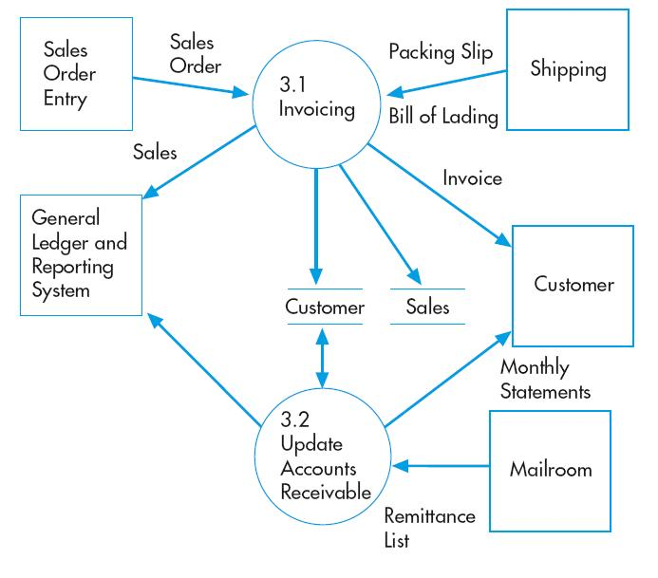
Billing
The third revenue cycle activity is billing customers.
This activity involves two tasks
Invoicing
Updating accounts receivable
Copyright © 2012 Pearson Education, Inc. publishing as Prentice Hall
12-30

Slide 31
Billing
Accurate and timely billing is crucial.
Billing is an information processing activity that repackages and summarizes information from the sales order entry and shipping activities.
Requires information from:
  Shipping Department on items and quantities shipped.
  Sales on prices and other sales terms.
The basic document created is the sales invoice. The invoice notifies the customer of:
  The amount to be paid.
  Where to send payment

Slide 32
PARTIAL ORGANIZATION CHART FOR UNITS INVOLVED IN REVENUE CYCLE

Slide 33
Billing
The accounts receivable function reports to the controller.
This function performs two basic tasks:
  Debits customer accounts for the amount the customer is invoiced.
  Credits customer accounts for the amount of customer payments.
Two basic ways to maintain accounts receivable:
  Open-invoice method
  Balance forward method

Slide 34
Billing
Open-invoice method:
  Customers pay according to each invoice.
  Two copies of the invoice are typically sent to the customer.
    Customer is asked to return one copy with payment.
    This copy is a turnaround document called a remittance advice.
  Advantages of open-invoice method:
    Conducive to offering early-payment discounts
    Results in more uniform flow of cash collections
  Disadvantages of open-invoice method:
    More complex to maintain

Slide 35
Billing
Balance forward method:
  Customers pay according to amount on their monthly statement, rather than by invoice.
  Monthly statement lists transactions since the last statement and lists the current balance
  Advantages of balance-forward method:
    It’s more efficient and reduces costs because you don’t bill for each individual sale.
    It’s more convenient for the customer to make one monthly remittance

Slide 36
Billing
Exception procedures: Account adjustments and write-offs:
  Adjustments to customer accounts may need to be made for:
    Returns
    Allowances for damaged goods
    Write-offs as uncollectible
  These adjustments are handled by the credit manager.

Slide 37
Billing Threats
Failure to bill
Billing errors
Posting errors in accounts receivable
Inaccurate or invalid credit memos
Copyright © 2012 Pearson Education, Inc. publishing as Prentice Hall
12-37

Slide 38
Billing Controls
Separation of billing and shipping functions
Periodic reconciliation of invoices with sales orders, picking tickets, and shipping documents
Configuration of system to automatically enter pricing data
Restriction of access to pricing master data
Data entry edit controls
Reconciliation of shipping documents (picking tickets, bills of lading, and packing list) to sales orders
Data entry controls
Reconciliation of batch totals
Mailing of monthly statements to customers
Reconciliation of subsidiary accounts to general ledger
Segregation of duties of credit memo authorization from both sales order entry and customer account maintenance
Configuration of system to block credit memos unless there is either corresponding documentation of return of damaged goods or specific authorization by management
Copyright © 2012 Pearson Education, Inc. publishing as Prentice Hall
12-38

Slide 39
Cash Collections
The final activity in the revenue cycle is collecting cash from customers.
The cashier, who reports to the treasurer, handles customer remittances and deposits them in the bank.
Because cash and checks are highly vulnerable, controls should be in place to discourage theft.
  Accounts receivable personnel should not have access to cash (including checks).
Copyright © 2012 Pearson Education, Inc. publishing as Prentice Hall
12-39

Slide 40
PARTIAL ORGANIZATION CHART FOR UNITS INVOLVED IN REVENUE CYCLE

Slide 41
Cash Collections
Possible approaches to collecting cash:
  Turnaround documents forwarded to accounts receivable. The mailroom opens customer envelopes and forwards to accounts receivable either:
  Remittance advices.
  Photocopies of remittance advices.
  A remittance list prepared in the mailroom.
  Lockbox arrangements
Customers remit payments to a bank P.O. box.
The bank sends the company:
  Remittance advices.
  An electronic list of the remittances.
  Copies of the checks.
Copyright © 2012 Pearson Education, Inc. publishing as Prentice Hall
12-41

Slide 42
Cash Collections
  Electronic lockboxes.
Upon receiving and scanning the checks, the bank immediately sends electronic notification to the company, including:
  Customer account number
  Amount remitted
Electronic funds transfer and bill payment
Customers remit payment electronically to the company’s bank.
Eliminates mailing delays.
Typically done through banking system’s Automated Clearing House (ACH) network.
PROBLEM: Some banks do not have both EDI and EFT capabilities, which complicates the task of crediting the customer’s account on a timely basis.

Slide 43
Cash Collections
  Financial electronic data interchange (FEDI).
Integrates EFT with EDI.
Remittance data and funds transfer instructions are sent simultaneously by the customer.
Requires that both buyer and seller use EDI-capable banks.
  Accept credit cards or procurement cards from customers.
Speeds collection because credit card issuer usually transfers funds within two days.
Typically costs 2–4% of gross sales price.

Slide 44
Cash Collections Threats
Theft of cash
Cash flow problems
Copyright © 2012 Pearson Education, Inc. publishing as Prentice Hall
12-44

Slide 45
Cash Collection Controls
Separation of cash handling function from accounts receivable and credit functions
Regular reconciliation of bank account with recorded amounts by someone independent of cash collections procedures
Use of EFT, FEDI, and lockboxes to minimize handling of customer payments by employees
Prompt, restrictive endorsement of all customer checks
Having two people open all mail likely to contain customer payments
Use of cash registers
Daily deposit of all cash receipts
Lockbox arrangements, EFT, or credit cards
Discounts for prompt payment by customers
Cash flow budgets
Copyright © 2012 Pearson Education, Inc. publishing as Prentice Hall
12-45

