Slide 1
Chapter 14
The Production Cycle

Slide 2
Learning Objectives
Describe the major business activities and related information processing operations performed in the production cycle.
Identify major threats in the production cycle and evaluate the adequacy of various control procedures for dealing with those threats.
Explain how a company’s cost accounting system can help it achieve its manufacturing goals.
Discuss the key decisions that must be made in the production cycle and identify the information required to make those decisions.

Slide 3
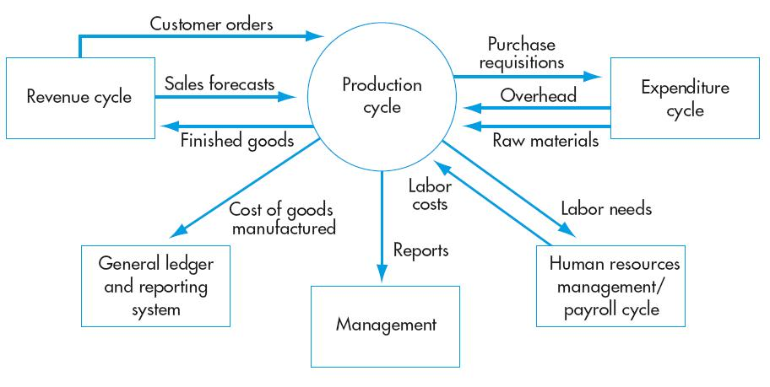
Production Cycle

Slide 4
The Production Cycle
Business activities and information processing activities
  Related to manufacturing of products
Information flows to the production cycle from other cycles, e.g.:
  The revenue cycle provides information on customer orders and sales forecasts for use in planning production and inventory levels.
  The expenditure cycle provides information about raw materials acquisitions and overhead costs.
  The human resources/payroll cycle provides information about labor costs and availability

Slide 5
The Production Cycle
Information also flows from the expenditure cycle:
  The revenue cycle receives information from the production cycle about finished goods available for sale.
  The expenditure cycle receives information about raw materials needs.
  The human resources/payroll cycle receives information about labor needs.
  The general ledger and reporting system receives information about cost of goods manufactured
Copyright © 2012 Pearson Education, Inc. publishing as Prentice Hall
14-5

Slide 6
The Production Cycle
Decisions that must be made in the production cycle include:
  What mix of products should be produced?
  How should products be priced?
  How should resources be allocated?
  How should costs be managed and performance evaluated?
These decisions require cost data well beyond that required for external financial statements.
Copyright © 2012 Pearson Education, Inc. publishing as Prentice Hall
14-6

Slide 7
The Production Cycle
The four basic activities in the production cycle are:
  Product design
  Planning and scheduling
  Production operations
  Cost accounting
Accountants are primarily involved in the fourth activity (cost accounting) but must understand the other processes well enough to design an AIS that provides needed information and supports these activities.
Copyright © 2012 Pearson Education, Inc. publishing as Prentice Hall
14-7

Slide 8
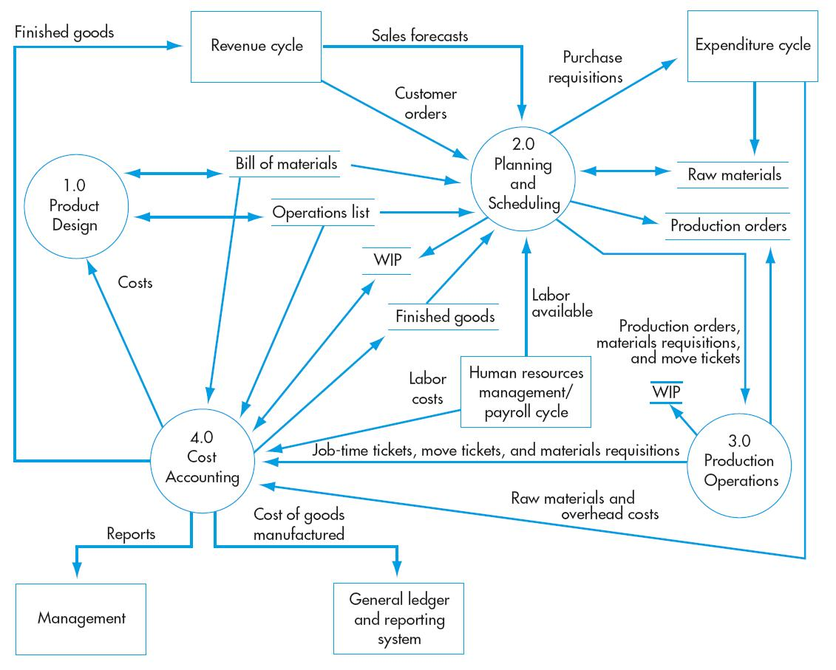
Production Cycle Activities
Product design
Planning and scheduling
Production operations
Cost accounting

Slide 9
Production Cycle General Threats
Inaccurate or invalid master data
Unauthorized disclosure of sensitive information
Loss or destruction of data

Slide 10
Production Cycle General Controls
Data processing integrity controls
Restriction of access to master data
Review of all changes to master data
Access controls
Encryption
Backup and disaster recovery procedures

Slide 11
Product Design
The objective of product design is to design a product that strikes the optimal balance of:
  Meeting customer requirements for quality, durability, and functionality; and
  Minimizing production costs.
Simulation software can improve the efficiency and effectiveness of product design.
Key documents and forms in product design:
  Bill of Materials: Lists the components that are required to build each product, including part numbers, descriptions, and quantity.
  Operations List: Lists the sequence of steps required to produce each product, including the equipment needed and the amount of time required.
Copyright © 2012 Pearson Education, Inc. publishing as Prentice Hall
14-11

Slide 12
Product Design
Role of the accountant in product design:
  Participate in the design, because 65−80% of product cost is determined at this stage.
  Add value by:
    (1) Designing an AIS that measures and collects the needed data.
    Information about current component usage.
    Information about machine set-up and materials-handling costs
    Data on repair and warranty costs to aid in future modification and design.
(2)Helping the design team use that data to improve profitability.
Compare current component usage with projected usage in alternate designs.
Compare current set-up and handling costs to projected costs in alternate designs.
Provide info on how design trade-offs affect total production cost and profitability
Copyright © 2012 Pearson Education, Inc. publishing as Prentice Hall
14-12

Slide 13
Product Design Threats and control
Poor product design resulting in excess costs
THREAT NO. 1—Poor product design
  Why is this a problem?
    Higher materials purchasing and carrying costs.
    Costs for inefficient production.
    Higher repair and warranty costs.
  Product Design Controls :
    Accurate data about the relationship between components and finished goods.
    Analysis of warranty and repair costs to identify primary causes of product failure to be used in re-designing product.

Slide 14
Planning and Scheduling
The second activity in production cycle is planning and scheduling the production
The objective of the planning and scheduling activity is to develop a production plan that is efficient enough to meet existing orders and anticipated shorter-term demand while minimizing inventories of both raw materials and finished goods.
There are two common approaches to production planning:
  Manufacturing Resource Planning (MRP-II)
  Lean Manufacturing

Slide 15
Planning and Scheduling
MRP-II is an extension of MRP inventory control systems:
  Seeks to balance existing production capacity and raw materials needs to meet forecasted sales demands.
  Often referred to as push manufacturing.
Lean manufacturing is an extension of the principles of just-in-time inventory systems:
  Seeks to minimize or eliminate inventories of raw materials, work in process, and finished goods.
  Theoretically, produces only in response to customer orders, but in reality, there are short-run production plans.
  Often referred to as pull manufacturing
Copyright © 2012 Pearson Education, Inc. publishing as Prentice Hall
14-15

Slide 16
Planning and Scheduling
Comparison of the two systems:
  Both plan production in advance.
  They differ in the length of the planning horizon.
    MRP-II develops plans for up to 12 months ahead.
    Lean manufacturing uses shorter planning horizons.
  Consequently:
    MRP-II is more appropriate for products with predictable demand and a long life cycle.
    Lean manufacturing more appropriate for products with unpredictable demand, short life cycles, and frequent markdowns of excess inventory.
Copyright © 2012 Pearson Education, Inc. publishing as Prentice Hall
14-16

Slide 17
Planning and Scheduling
Key documents and forms:
  Master production schedule
Specifies how much of each product is to be produced during the period and when.
Uses information about customer orders, sales forecasts, and finished goods inventory levels to determine production levels.
Although plans can be modified, production plans must be frozen a few weeks in advance to provide time to procure needed materials and labor.
Scheduling becomes significantly more complex as the number of factories increases.
Raw materials needs are determined by exploding the bill of materials to determine amount needed for current production. These amounts are compared to available levels to determine amounts to be purchased
Copyright © 2012 Pearson Education, Inc. publishing as Prentice Hall
14-17

Slide 18
Planning and Scheduling
(2) Production order
Authorizes production of a specified quantity of a product. It lists:
  Operations to be performed
  Quantity to be produced
  Location for delivery
Also collects data about these activities
(3) Materials requisition
Authorizes movement of the needed materials from the storeroom to the factory floor.
This document indicates:
  Production order number
  Date of issue
  Part numbers and quantities of raw materials needed (based on data in bill of materials
Copyright © 2012 Pearson Education, Inc. publishing as Prentice Hall
14-18

Slide 19
Planning and Scheduling
(4) Move ticket
Documents the transfer of parts and materials throughout the factory.
How can information technology help?
  Improve the efficiency of material-handling activities by using:
    Bar coding of materials to improve speed and accuracy,
    RFID tags can eliminate human intervention in the scanning process
Role of the accountant:
  Ensure the AIS collects and reports costs in a manner consistent with the company’s production planning techniques
Copyright © 2012 Pearson Education, Inc. publishing as Prentice Hall
14-19

Slide 20
Planning and Scheduling Threats and control
THREAT NO. 2—Over- or under-production
    Over-production may result in:
      Excess goods for short-run demand and potential cash flow problems.
      Obsolete inventory تقادم المخزون.
    Under-production may result in:
      Lost sales.
      Customer dissatisfaction.
  Controls:
    More accurate production planning, including accurate and current:
      Sales forecasts
      Inventory data
    Investments in production planning.
    Regular collection of data on production performance to adjust production schedule.
    Proper authorization of production orders.
    Restriction of access to production scheduling program.
    Validity checks on production orders
Copyright © 2012 Pearson Education, Inc. publishing as Prentice Hall
14-20

Slide 21
Production Operations
Production operations vary greatly across companies, depending on the type of product and the degree of automation.
The use of various forms of IT, such as robots and computer-controlled machinery is called computer-integrated manufacturing (CIM).
  Can significantly reduce production costs.
Accountants aren’t experts on CIM, but they must understand how it affects the AIS.
  One effect is a shift from mass production to custom-order manufacturing and the need to accumulate costs accordingly.

Slide 22
Production Operations
In a lean manufacturing environment, a customer order triggers several actions:
  System first checks inventory on hand for sufficiency.
  Calculates labor needs and determines whether overtime or temporary help will be needed.
  Based on bill of materials, determines what components need to be ordered.
    Necessary purchase orders are sent via EDI.
  The master production schedule is adjusted to include the new order.
Copyright © 2012 Pearson Education, Inc. publishing as Prentice Hall
14-22

Slide 23
Production Operations
Sharing information across cycles helps companies be more efficient by timing purchases to meet the actual demand.
Although the nature of production processes and the extent of CIM vary, all companies need data on:
  Raw materials used
  Labor hours expended
  Machine operations performed
  Other manufacturing overhead costs incurred
Copyright © 2012 Pearson Education, Inc. publishing as Prentice Hall
14-23

Slide 24
Production Operations Threats and Controls
THREAT NO. 4—Theft of inventories and fixed assets
  Why is this a problem?
    Loss of assets.
    Misstated financial data.
    Potential underproduction of inventory.
  Controls:
    Physical access to inventory should be restricted.
    All internal movement of inventory should be documented.
THREAT NO. 5—Disruption of operations (توقف العمليات
  Why is this a problem?
    Disasters can disrupt functioning and destroy assets
  Controls:
    Backup power sources, such as generators and uninterruptible power supplies.
    Investigate disaster preparedness (الجاهزية) of key suppliers and identify alternative sources for critical components.
Copyright © 2012 Pearson Education, Inc. publishing as Prentice Hall
14-24

Slide 25
Production Operations Threats
Theft of inventory
Theft of fixed asset
Poor performance
Suboptimal investment in fixed assets
Loss of inventory or fixed assets due to fire or other disasters
Disruption of operations
Copyright © 2012 Pearson Education, Inc. publishing as Prentice Hall
14-25

Slide 26
Production Operations Controls
Physical access control
Documentation of all inventory movement
Segregation of duties—custody of assets from recording and authorization of removal
Restriction of access to inventory master data
Periodic physical counts of inventory and reconciliation of those counts to recorded quantities
Physical inventory of all fixed assets
Restriction of physical access to fixed assets
Maintaining detailed records of fixed assets, including disposal
Training
Performance reports
Proper approval of fixed asset acquisitions, including use of requests for proposals to solicit multiple competitive bids
Physical safeguards (e.g., fire sprinklers)
Insurance
Backup and disaster recovery plans

Slide 27
Cost Accounting
Accountants are primarily involved in the fourth activity (cost accounting) but must understand the other processes well enough to design an AIS that provides needed information and supports these activities.
The objectives of cost accounting are:
  To provide information for planning, controlling, and evaluating the performance of production operations;
  To provide accurate cost data about products for use in pricing and product mix decisions; and
  To collect and process information used to calculate inventory and COGS values for the financial statements.

Slide 28
Cost Accounting
: Types of cost accounting systems
  (1) Job order costing
  Assigns costs to a specific production batch or job.
  Used when the product or service consists of discretely identifiable items
  Example: Houses
  (2) Process costing
  Assigns costs to each process or work center in the production cycle.
  Calculates the average cost for all units produced
  Used when similar goods or services are produced in mass quantities and discrete units can’t be easily identified
  Example: Paint.
Copyright © 2012 Pearson Education, Inc. publishing as Prentice Hall
14-28

Slide 29
Cost Accounting
(3) Activity-Based Costing
  Traces costs to the activities that create them
  Uses a greater number of overhead pools
    Batch
    Product
    Organization
  Identifies cost drivers
    Cause-and-effect relationship
Accounting for fixed assets:
  The AIS must collect and process information about the property, plant, and equipment used in the production cycle.
  These assets represent a significant portion of total assets for many companies and need to be monitored as an investment.
Copyright © 2012 Pearson Education, Inc. publishing as Prentice Hall
14-29

Slide 30
Cost Accounting
The following information should be maintained about each fixed asset:
ID number
Serial number
Location
Cost
Acquisition date
Vendor info
Expected life
Expected salvage value
Depreciation method
Accumulated depreciation
Improvements
Maintenance performed
Copyright © 2012 Pearson Education, Inc. publishing as Prentice Hall
14-30

Slide 31
Cost Accounting
The purchase of fixed assets follows the same processes as other purchases in the expenditure cycle (order → receive → pay).
But the amounts involved necessitate some modification to the process:
  Competitive bidding
  Number of people involved
  Payment
  Controls
  Disposal
Copyright © 2012 Pearson Education, Inc. publishing as Prentice Hall
14-31

Slide 32
Cost Accounting
A typical AIS would look something like the following:
  (1) Product design
Engineering specifications result in new records for both the bill of materials and the operations list file.
To create these lists, engineering accesses both files to view designs of similar products.
They also access the general ledger and inventory files for info about alternate designs.
  (2) Production planning
The sales department enters sales forecasts and customer special order information.
Production planning uses that information and data on current inventory levels to develop a master production schedule.
New records are added to the production order file to authorize the production of goods.
Copyright © 2012 Pearson Education, Inc. publishing as Prentice Hall
14-32

Slide 33
Cost Accounting
  (3) Cost accounting
  New records are added to the work-in-process file to accumulate cost data
  (4) Production operations
The list of operations to be performed is displayed at workstations.
Instructions are also sent to the CIM interface to guide operation of machinery and robots.
Materials requisitions are sent to inventory stores to authorize release of raw materials to production.
Copyright © 2012 Pearson Education, Inc. publishing as Prentice Hall
14-33

Slide 34
Cost Accounting
Such a system can be used for a job-order or process costing system.
Both require that data be accumulated about:
  Raw materials
  Direct labor
  Machinery and equipment usage
  Manufacturing overhead
The choice of method:
  Does not affect how data are collected
  Does affect how costs are assigned to products
Copyright © 2012 Pearson Education, Inc. publishing as Prentice Hall
14-34

Slide 35
Cost Accounting
Raw material usage data:
  When production is initiated, the issuance of a materials requisition triggers a debit (increase) to work in process and a credit (decrease) to raw materials inventory.
  Work in process is credited and raw materials are debited for any amounts returned to inventory.
  Many raw materials are bar coded so that usage data is collected by scanning.
  RFID tags improve the efficiency of tracking material usage.
  Usage may be entered online for materials such as liquids that are not conducive to tagging.
Copyright © 2012 Pearson Education, Inc. publishing as Prentice Hall
14-35

Slide 36
Cost Accounting
Direct labor costs:
  Historically, job time tickets were used to record the time a worker spent on each job task.
  Currently, workers may:
    Enter the data on online terminals.
    Use coded ID badges, which are run through a badge reader at the beginning and end of each job.
Machinery and equipment usage:
  Machinery costs make up an ever-increasing proportion of production costs.
  Data about machinery and equipment are collected at each production step, often with data about labor costs.
  Until recently, data was collected by wiring the factory so all equipment was linked to the computer system.
    Limits the ability to rearrange the shop floor.
  3-D simulations can be used to assess the impact of altering floor layout.
Copyright © 2012 Pearson Education, Inc. publishing as Prentice Hall
14-36

Slide 37
Cost Accounting
Manufacturing overhead costs:
  Includes costs that can’t be easily traced to jobs or processes, such as utilities, depreciation, supervisory salaries.
  Most of these costs are collected in the expenditure cycle.
  An exception is supervisory salaries, which are collected in the HRM/payroll cycle
Accountants help control overhead by assessing how product mix changes will affect overhead costs.
  They should also identify the factors that drive the changes in these costs.
    This information can be used to realign processes and layout.
  Accurate and complete information about production cycle activities are required to perform these analyses.
Copyright © 2012 Pearson Education, Inc. publishing as Prentice Hall
14-37

Slide 38
Cost Accounting Threats and Control
THREAT 6—Inaccurate recording and processing of production activity data
  Why is this a problem?
    Diminishes effectiveness of production scheduling.
    Undermines management’s ability to monitor and control operations.
  Controls:
    Automate data collection with RFID technology, bar code scanners, and badge readers to ensure accurate data entry.
    Use online terminals for data entry.
    Restrict access with passwords, user IDs, and access control matrices to prevent unauthorized changes to data.
    Use check digits, closed-loop verification, and validity checks.
    Do periodic physical counts of inventory and compare to records.
    Do periodic inspections and counts of fixed assets
Copyright © 2012 Pearson Education, Inc. publishing as Prentice Hall
14-38

Slide 39
General threats
THREAT NO. 7: Loss, alteration, or unauthorized disclosure of data
  Why is this a problem?
    Loss or alteration of data could cause:
      Errors in external or internal reporting.
    Unauthorized disclosure of confidential information can cause:
      Unfair competition
      Loss of business
Controls:
  All data files and key master files should be backed up regularly.
    At least one backup on site and one offsite.
  All disks and tapes should have external and internal file labels to reduce chance of accidentally erasing important data.
  Promptly, remove all access rights of employees who quit or are fired
Copyright © 2012 Pearson Education, Inc. publishing as Prentice Hall
14-39

Slide 40
General threats
THREAT NO. 8—Poor performance
  Why is this a problem?
    Quality control problems increase expenses and reduce future sales.
  Controls:
    Prepare and review performance reports.
Copyright © 2012 Pearson Education, Inc. publishing as Prentice Hall
14-40

Slide 41
Production Cycle Information Needs
In a manufacturing environment, the focus must be on total quality management. Managers need info on:
  Defect rates
  Breakdown frequency
  Percent of finished goods needing rework
  Percent of defects discovered by customers
Two major criticisms have been directed at traditional cost accounting systems (job order and process):
  Overhead costs are inappropriately allocated to products. Usually they use volume-driven bases; such as direct labor or machine hours to apply overhead cost to product.
  Reports do not accurately reflect effects of factory automation.
Copyright © 2012 Pearson Education, Inc. publishing as Prentice Hall
14-41

Slide 42
CRITICISM 1: INAPPROPRIATE ALLOCATION OF OVERHEAD COSTS
Traditional cost accounting systems use volume-driven bases such as direct labor hours or machine hours to apply overhead.
However, overhead does not vary with production volume.
EXAMPLE: Purchasing costs vary with the number of purchase orders processed.
Allocating overhead based on output volume:
  Overstates the costs of products manufactured in large quantities.
  Understates the costs of products manufactured in small batches.
Also, allocating overhead based on direct labor input can distort costs
Copyright © 2012 Pearson Education, Inc. publishing as Prentice Hall
14-42

Slide 43
CRITICISM 1: INAPPROPRIATE ALLOCATION OF OVERHEAD COSTS
Example of two products:
  Product one uses:
    $5 of materials
    1 hour of labor
    5 minutes of machine time
  Product two uses:
    $5 of materials
    1 hour of labor
    42 hours of machine time on very expensive equipment
Under a traditional cost accounting system, both products will appear to have the same cost
Copyright © 2012 Pearson Education, Inc. publishing as Prentice Hall
14-43

Slide 44
CRITICISM 1: INAPPROPRIATE ALLOCATION OF OVERHEAD COSTS
Solution to criticism 1: Activity Based Costing (ABC)
  ABC can refine and improve cost allocations under either job-order or process costing systems.
    ABC traces costs to the activities that create them and allocates them accordingly.
    ABC aims to link costs to corporate strategy.
  Corporate strategy results in decisions about what goods and services to produce.
    These activities incur costs.
    So corporate strategy determines costs.
  By measuring the costs of the basic activities, ABC provides information to management for evaluating the consequences of their decisions.
Copyright © 2012 Pearson Education, Inc. publishing as Prentice Hall
14-44

Slide 45
CRITICISM 1: INAPPROPRIATE ALLOCATION OF OVERHEAD COSTS
ABC vs. traditional cost systems:
  There are three significant differences between ABC and traditional cost accounting approaches.
    Tracing of overhead costs
    Number of cost pools
    Identification of cost drivers
Copyright © 2012 Pearson Education, Inc. publishing as Prentice Hall
14-45

