Slide 1


Slide 2
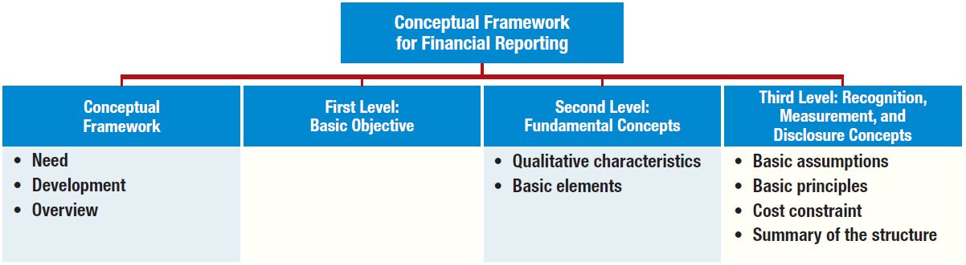
PREVIEW OF CHAPTER
2
Intermediate Accounting
IFRS 2nd Edition
Kieso, Weygandt, and Warfield

Slide 3


LEARNING OBJECTIVES
2
Conceptual Framework
for Financial Reporting
After studying this chapter, you should be able to:
Describe the usefulness of a conceptual framework.
Describe efforts to construct a conceptual framework.
Understand the objective of financial reporting.
Identify the qualitative characteristics of accounting information.
Define the basic elements of financial statements.
Describe the basic assumptions of accounting.
Explain the application of the basic principles of accounting.
Describe the impact that the cost constraint has on reporting accounting information.

Slide 4
CONCEPTUAL FRAMEWORK
Conceptual Framework establishes the concepts that underlie financial reporting.
Need for a Conceptual Framework
Rule-making should build on and relate to an established body of concepts.
Enables IASB to issue more useful and consistent pronouncements over time.
LO 1

Slide 5
CONCEPTUAL FRAMEWORK
Overview of the Conceptual Framework
Three levels:
  First Level = Objectives of Financial Reporting
  Second Level = Qualitative Characteristics and Elements of Financial Statements
  Third Level = Recognition, Measurement, and Disclosure Concepts.
LO 2

Slide 6
ASSUMPTIONS
Economic entity
Going concern
Monetary unit
Periodicity
Accrual
PRINCIPLES
Measurement
Revenue recognition
Expense recognition
Full disclosure
CONSTRAINTS
Cost
Third level
The "how"—
implementation
QUALITATIVE CHARACTERISTICS
  Fundamental qualities
  Enhancing qualities
ELEMENTS
Assets
Liabilities
Equity
Income
Expenses
Second level
Bridge between
levels 1 and 3
ILLUSTRATION 2-7 Conceptual Framework for Financial Reporting
OBJECTIVE
Provide information about the reporting
entity that is useful
to present and potential
equity investors,
lenders, and other
creditors in their
capacity as capital
providers.
First level
The "why"—purpose
of accounting

Slide 7
FIRST LEVEL: BASIC OBJECTIVE
OBJECTIVE
“To provide financial information about the reporting entity that is useful to present and potential equity investors, lenders, and other creditors in making decisions about providing resources to the entity.
Provided by issuing general-purpose financial statements.
Assumption is that users need reasonable knowledge of business and financial accounting matters to understand the information.
LO 3

Slide 8
SECOND LEVEL: FUNDAMENTAL CONCEPTS
Qualitative Characteristics of Accounting Information
IASB identified the Qualitative Characteristics of accounting information that distinguish better (more useful) information from inferior (less useful) information for decision-making purposes.
LO 4

Slide 9
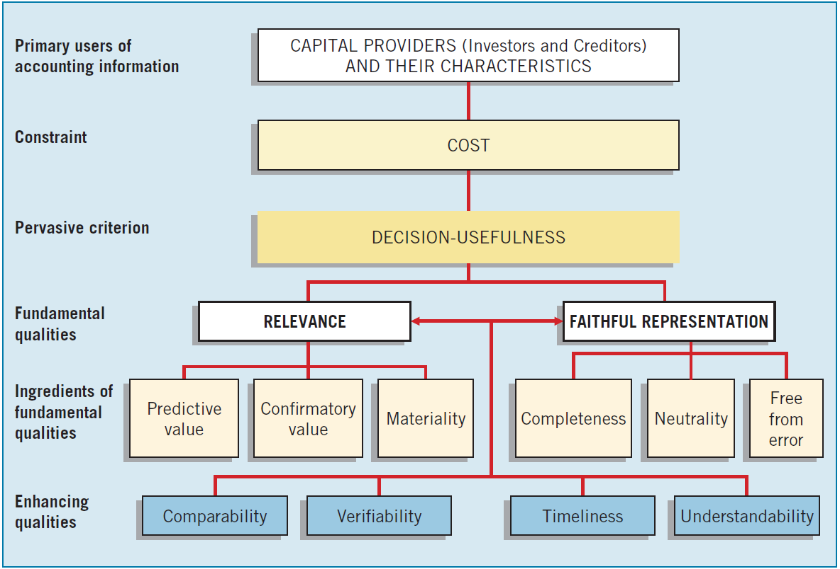
SECOND LEVEL: FUNDAMENTAL CONCEPTS
ILLUSTRATION 2-2 Hierarchy of Accounting Qualities
LO 4

Slide 10
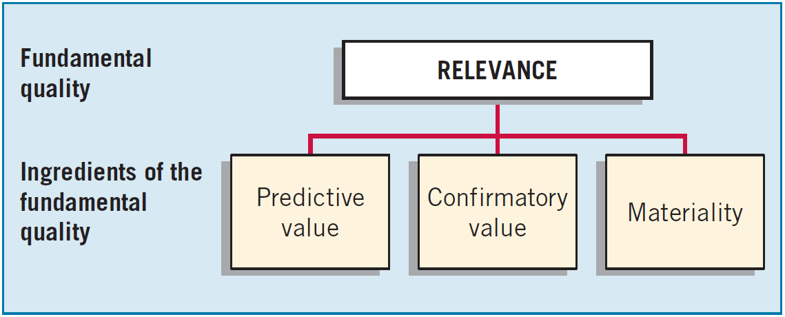
SECOND LEVEL: FUNDAMENTAL CONCEPTS
Fundamental Quality—Relevance
To be relevant, accounting information must be capable of making a difference in a decision.
LO 4

Slide 11
SECOND LEVEL: FUNDAMENTAL CONCEPTS
Fundamental Quality—Relevance
Financial information has predictive value if it has value as an input to predictive processes used by investors to form their own expectations about the future.
LO 4

Slide 12
SECOND LEVEL: FUNDAMENTAL CONCEPTS
Fundamental Quality—Relevance
Relevant information also helps users confirm or correct prior expectations.
LO 4

Slide 13
SECOND LEVEL: FUNDAMENTAL CONCEPTS
Fundamental Quality—Relevance
Information is material if omitting it or misstating it could influence decisions that users make on the basis of the reported financial information.
LO 4

Slide 14
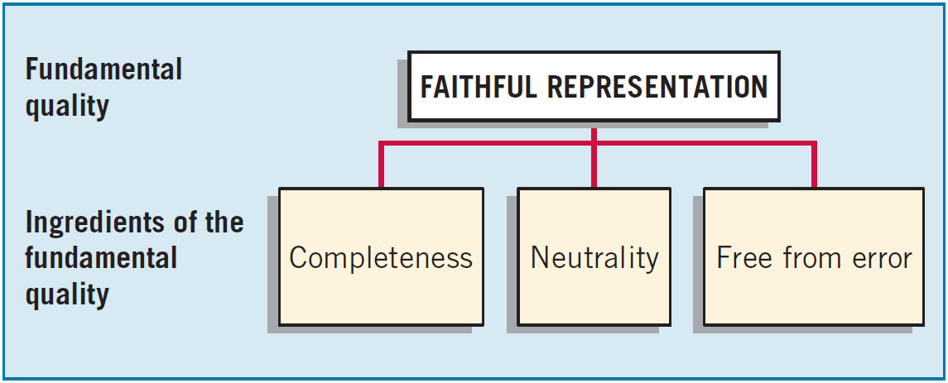
SECOND LEVEL: FUNDAMENTAL CONCEPTS
Fundamental Quality—Faithful Representation
Faithful representation means that the numbers and descriptions match what really existed or happened.
LO 4

Slide 15
SECOND LEVEL: FUNDAMENTAL CONCEPTS
Fundamental Quality—Faithful Representation
Completeness means that all the information that is necessary for faithful representation is provided.
LO 4

Slide 16
SECOND LEVEL: FUNDAMENTAL CONCEPTS
Fundamental Quality—Faithful Representation
Neutrality means that a company cannot select information to favor one set of interested parties over another.
LO 4

Slide 17
SECOND LEVEL: FUNDAMENTAL CONCEPTS
Fundamental Quality—Faithful Representation
An information item that is free from error will be a more accurate (faithful) representation of a financial item.
LO 4

Slide 18
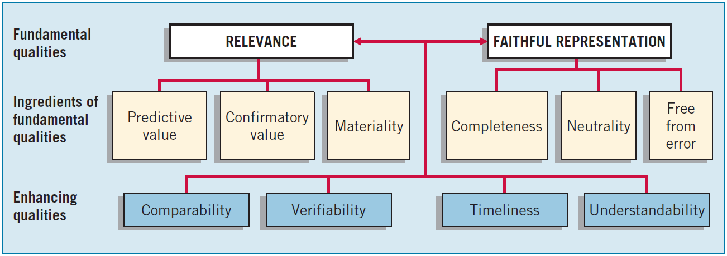
SECOND LEVEL: FUNDAMENTAL CONCEPTS
Enhancing Qualities
Information that is measured and reported in a similar manner for different companies is considered comparable.
LO 4

Slide 19
SECOND LEVEL: FUNDAMENTAL CONCEPTS
Enhancing Qualities
Verifiability occurs when independent measurers, using the same methods, obtain similar results.
LO 4

Slide 20
SECOND LEVEL: FUNDAMENTAL CONCEPTS
Enhancing Qualities
Timeliness means having information available to decision-makers before it loses its capacity to influence decisions.
LO 4

Slide 21
SECOND LEVEL: FUNDAMENTAL CONCEPTS
Enhancing Qualities
Understandability is the quality of information that lets reasonably informed users see its significance.
LO 4

Slide 22
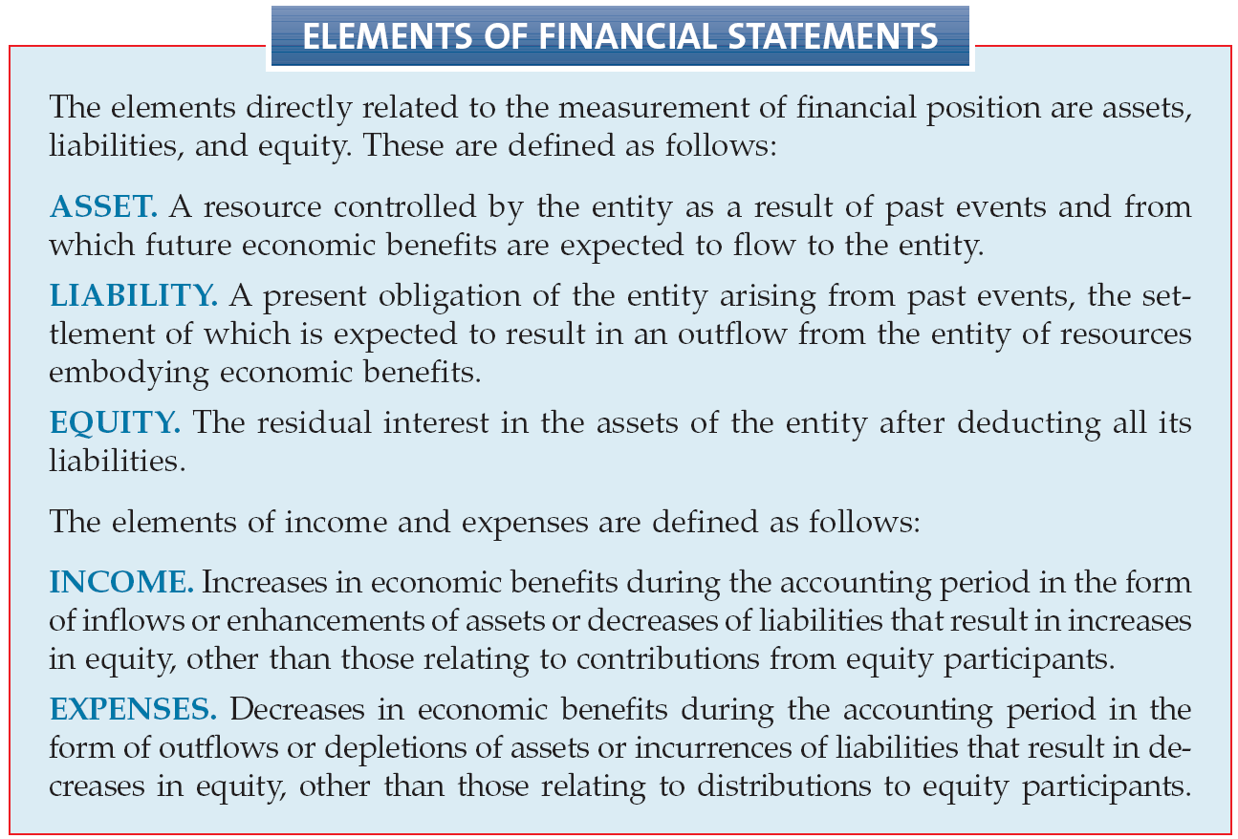
Second Level: Basic Elements
LO 5 Define the basic elements of financial statements.

Slide 23
SECOND LEVEL: BASIC ELEMENTS
Exercise 2-4: Identify the qualitative characteristic(s) to be used given the information provided.
Characteristics
  Qualitative characteristic being displayed when companies in the same industry are using the same accounting principles.
  Quality of information that confirms users’ earlier expectations.
  Imperative for providing comparisons of a company from period to period.
  Ignores the economic consequences of a standard or rule.
  Relevance
  Faithful representation
  Predictive value
  Confirmatory value
  Neutrality
  Materiality
  Timeliness
  Verifiability
  Understandability
  Comparability
LO 5

Slide 24
SECOND LEVEL: BASIC ELEMENTS
Exercise 2-4: Identify the qualitative characteristic(s) to be used given the information provided.
Characteristics
  Requires a high degree of consensus among individuals on a given measurement.
  Predictive value is an ingredient of this fundamental quality of information.
  Four qualitative characteristics that enhance both relevance and faithful representation.
  An item is not reported because its effect on income would not change a decision.
  Relevance
  Faithful representation
  Predictive value
  Confirmatory value
  Neutrality
  Materiality
  Timeliness
  Verifiability
  Understandability
  Comparability
LO 5

Slide 25
SECOND LEVEL: BASIC ELEMENTS
Exercise 2-4: Identify the qualitative characteristic(s) to be used given the information provided.
Characteristics
  Neutrality is a key ingredient of this fundamental quality of accounting information.
  Two fundamental qualities that make accounting information useful for decision-making purposes.
  Issuance of interim reports is an example of what enhancing ingredient?
  Relevance
  Faithful representation
  Predictive value
  Confirmatory value
  Neutrality
  Materiality
  Timeliness
  Verifiability
  Understandability
  Comparability
LO 5

Slide 26
THIRD LEVEL: RECOGNITION, MEASUREMENT, AND DISCLOSURE CONCEPTS
These concepts explain how companies should recognize, measure, and report financial elements and events.
Recognition, Measurement, and Disclosure Concepts
ASSUMPTIONS
Economic entity
Going concern
Monetary unit
Periodicity
Accrual
PRINCIPLES
Measurement
Revenue recognition
Expense recognition
Full disclosure
CONSTRAINTS
Cost
ILLUSTRATION 2-7 Conceptual Framework for Financial Reporting
LO 6

Slide 27
THIRD LEVEL: ASSUMPTIONS
Basic Assumptions
Economic Entity – company keeps its activity separate from its owners and other business unit.
Going Concern - company to last long enough to fulfill objectives and commitments.
Monetary Unit - money is the common denominator.
Periodicity - company can divide its economic activities into time periods.
Accrual Basis of Accounting – transactions are recorded in the periods in which the events occur.
LO 6

Slide 28
THIRD LEVEL: ASSUMPTIONS
BE2-8: Identify which basic assumption of accounting is best described in each item below.
The economic activities of FedEx Corporation (USA) are divided into 12-month periods for the purpose of issuing annual reports.
Total S.A. (FRA) does not adjust amounts in its financial statements for the effects of inflation.
Barclays (GBR) reports current and non-current classifications in its statement of financial position.
The economic activities of Tokai Rubber Industries (JPN) and its subsidiaries are merged for accounting and reporting purposes.
Periodicity
Monetary
Unit
Going Concern
Economic
Entity
LO 6

Slide 29
THIRD LEVEL: BASIC PRINCIPLES
Measurement Principles
  Historical Cost is generally thought to be a faithful representation of the amount paid for a given item.
  Fair value is defined as “the price that would be received to sell an asset or paid to transfer a liability in an orderly transaction between market participants at the measurement date.”
  IASB has given companies the option to use fair value as the basis for measurement of financial assets and financial liabilities.
LO 7

Slide 30
THIRD LEVEL: BASIC PRINCIPLES
Revenue Recognition
When a company agrees to perform a service or sell a product to a customer, it has a performance obligation.
Requires that companies recognize revenue in the accounting period in which the performance obligation is satisfied.
LO 7

Slide 31
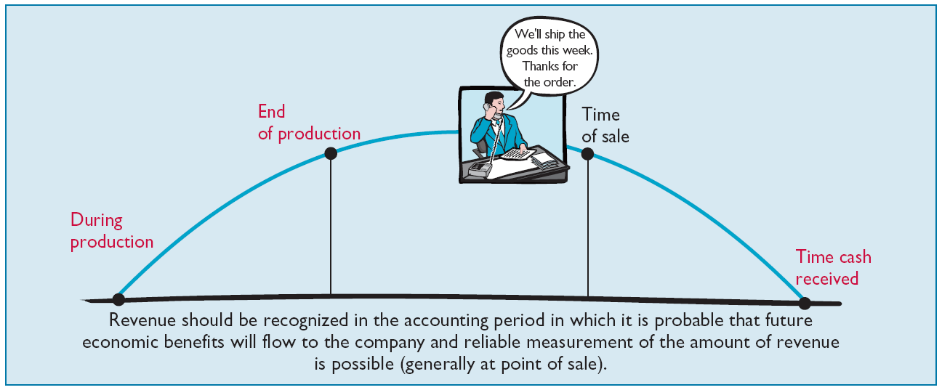
Third Level: Principles
Revenue Recognition - revenue is to be recognized when it is probable that future economic benefits will flow to the company and reliable measurement of the amount of revenue is possible.
Illustration 2-3 Timing of Revenue Recognition
LO 7 Explain the application of the basic principles of accounting.

Slide 32
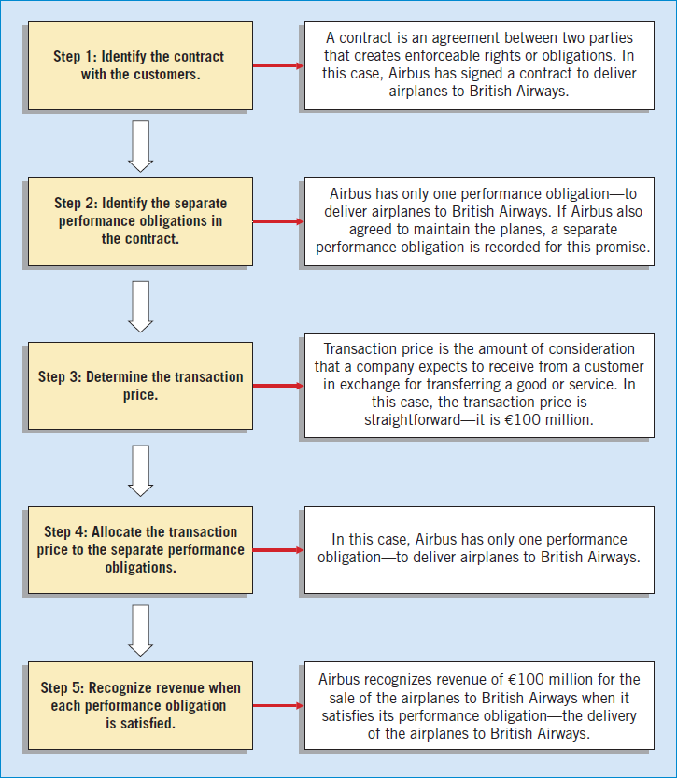
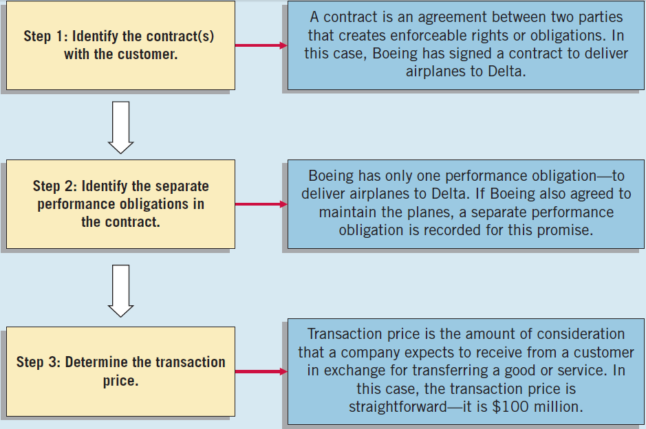
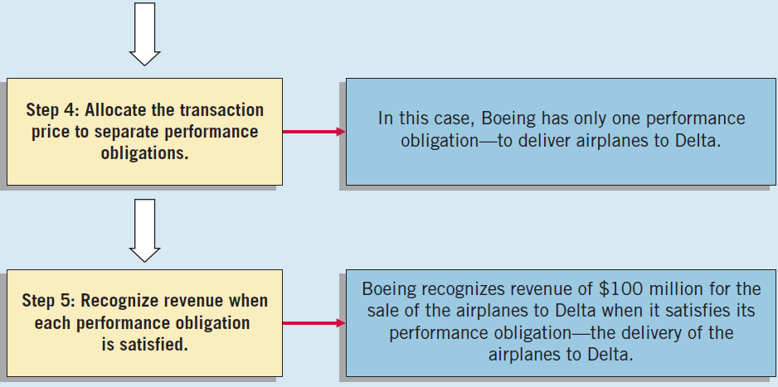
THIRD LEVEL: BASIC PRINCIPLES
Illustration: Assume the Airbus (DEU) signs a contract to sell airplanes to British Airways (GRB) for €100 million. To determine when to recognize revenue, Airbus uses the five steps for revenue recognition shown at right.
ILLUSTRATION 2-5
The Five Steps of Revenue Recognition

Slide 33
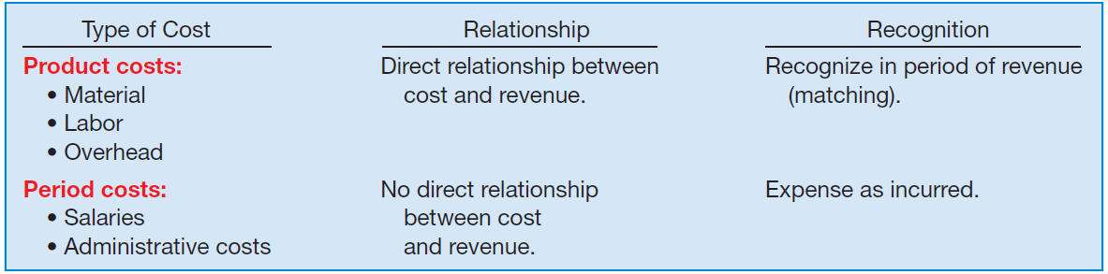
THIRD LEVEL: BASIC PRINCIPLES
Expense Recognition - Outflows or “using up” of assets or incurring of liabilities during a period as a result of delivering or producing goods and/or rendering services.
ILLUSTRATION 2-6 Expense Recognition
“Let the expense follow the revenues.”
LO 7

Slide 34
THIRD LEVEL: BASIC PRINCIPLES
Full Disclosure
Providing information that is of sufficient importance to influence the judgment and decisions of an informed user.
Provided through:
  Financial Statements
  Notes to the Financial Statements
  Supplementary information
LO 7

Slide 35
THIRD LEVEL: BASIC PRINCIPLES
BE2-9: Identify which basic principle of accounting is best described in each item below.
(a) Parmalat (ITA) reports revenue in its income statement when it delivered goods instead of when the cash is collected.
(b) Google (USA) recognizes depreciation expense for a machine over the 2-year period during which that machine helps the company earn revenue.
(c) KC Corp. (USA) reports information about pending lawsuits in the notes to its financial statements.
(d) Fuji Film (JPN) reports land on its statement of financial position at the amount paid to acquire it, even though the estimated fair market value is greater.
Revenue
Recognition
Expense
Recognition
Full
Disclosure
Measurement
LO 7

Slide 36
THIRD LEVEL: COST CONSTRAINT
Cost Constraint
Companies must weigh the costs of providing the information against the benefits that can be derived from using it.
  Rule-making bodies and governmental agencies use cost-benefit analysis before making final their informational requirements.
  In order to justify requiring a particular measurement or disclosure, the benefits perceived to be derived from it must exceed the costs perceived to be associated with it.
LO 8

Slide 37
THIRD LEVEL: COST CONSTRAINT
BE2-11: Determine whether you would classify these transactions as material.
In the current year, Blair Co. reduces its bad debt expense to ensure another positive earnings year. The impact of this adjustment is equal to 3% of net income.
Damon Co. expenses all capital equipment under €2,500 on the basis that it is immaterial. The company has followed this practice for a number of years.
Material
Likely not material
LO 8

Slide 38

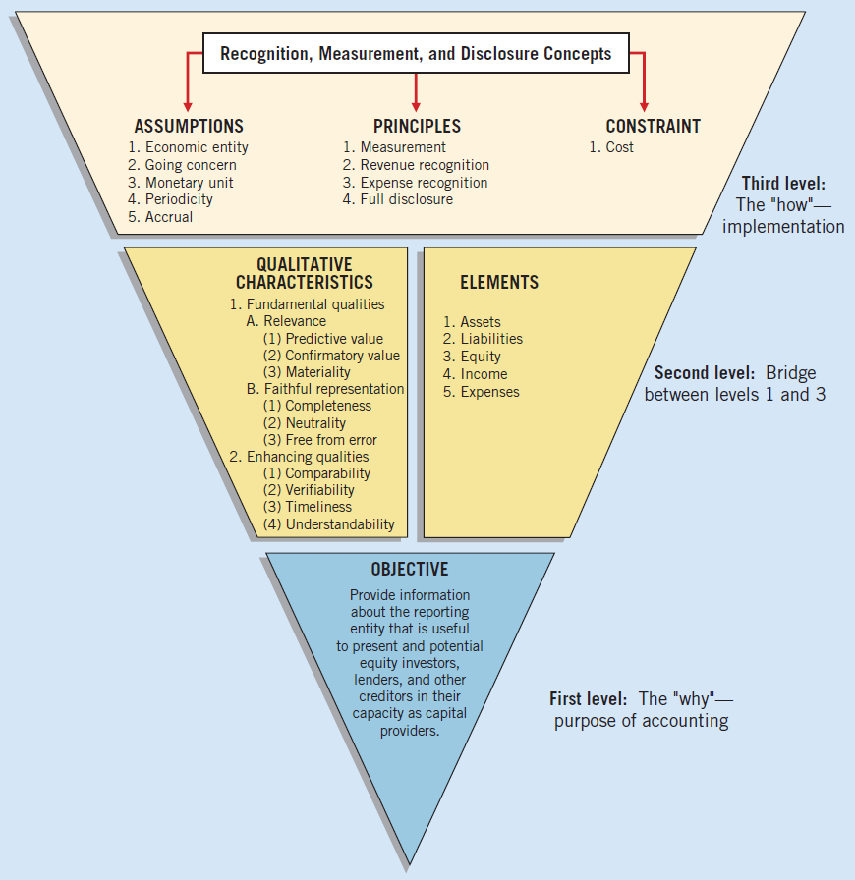
Summary of the Structure
ILLUSTRATION 2-7 Conceptual Framework for Financial Reporting
LO 8

Slide 39


GLOBAL ACCOUNTING INSIGHTS
THE CONCEPTUAL FRAMEWORK
The IASB and the FASB have been working together to develop a common conceptual framework. This framework is based on the existing conceptual frameworks underlying U.S. GAAP and IFRS. The objective of this joint project is to develop a conceptual framework consisting of standards that are principles-based and internally consistent, thereby leading to the most useful financial reporting.

Slide 40
GLOBAL ACCOUNTING INSIGHTS
Relevant Facts
Following are the key similarities and differences between U.S. GAAP and IFRS related to the Conceptual Framework for Financial Reporting.
Similarities
In 2010, the IASB and FASB completed the first phase of a jointly created conceptual framework. In this first phase, they agreed on the objective of financial reporting and a common set of desired qualitative characteristics. These were presented in the Chapter 2 discussion. Note that prior to this converged phase, the Conceptual Framework gave more emphasis to the objective of providing information on management’s performance (stewardship).

Slide 41
GLOBAL ACCOUNTING INSIGHTS
Relevant Facts
Similarities
The existing conceptual frameworks underlying U.S. GAAP and IFRS are very similar. That is, they are organized in a similar manner (objective, elements, qualitative characteristics, etc.). There is no real need to change many aspects of the existing frameworks other than to converge different ways of discussing essentially the same concepts.
The converged framework should be a single document, unlike the two conceptual frameworks that presently exist. It is unlikely that the basic structure related to the concepts will change.

Slide 42
GLOBAL ACCOUNTING INSIGHTS
Relevant Facts
Similarities
Both the IASB and FASB have similar measurement principles, based on historical cost and fair value. In 2011, the Boards issued a converged standard on fair value measurement so that the definition of fair value, measurement techniques, and disclosures are the same between U.S. GAAP and IFRS when fair value is used in financial statements.
Differences
Although both U.S. GAAP and IFRS are increasing the use of fair value to report assets, at this point IFRS has adopted it more broadly. As examples, under IFRS, companies can apply fair value to property, plant, and equipment; natural resources; and, in some cases, intangible assets.

Slide 43
GLOBAL ACCOUNTING INSIGHTS
Relevant Facts
Differences
U.S. GAAP has a concept statement to guide estimation of fair values when market-related data is not available (Statement of Financial Accounting Concepts No. 7, “Using Cash Flow Information and Present Value in Accounting”). The IASB has not issued a similar concept statement; it has issued a fair value standard (IFRS 13) that is converged with U.S. GAAP.
The monetary unit assumption is part of each framework. However, the unit of measure will vary depending on the currency used in the country in which the company is incorporated (e.g., Chinese yuan, Japanese yen, and British pound).

Slide 44
GLOBAL ACCOUNTING INSIGHTS
Relevant Facts
Differences
The economic entity assumption is also part of each framework although some cultural differences result in differences in its application. For example, in Japan many companies have formed alliances that are so strong that they act similar to related corporate divisions although they are not actually part of the same company.

