Slide 1
Chapter 15
The Human Resources Management and Payroll Cycle
15-1
Copyright © 2012 Pearson Education, Inc. publishing as Prentice Hall

Slide 2
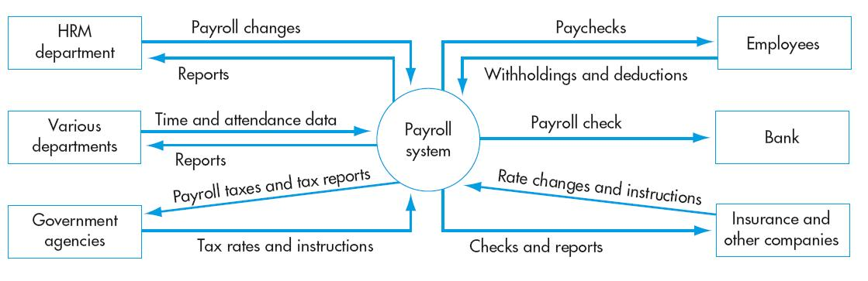
HRM and Payroll Cycle
Copyright © 2012 Pearson Education, Inc. publishing as Prentice Hall
15-2

Slide 3
INTRODUCTION
The HRM/payroll cycle is a recurring set of business activities and related data processing operations associated with effectively managing the employee workforce.
The more important tasks performed in the HRM/payroll cycle are:
  Recruiting and hiring new employees
  Training
  Job assignment
  Compensation (payroll)
  Performance evaluation
  Discharge of employees (voluntarily or involuntarily)
Payroll costs are also allocated to products and departments for use in product pricing and mix decisions.

Slide 4
INTRODUCTION
The most important tasks performed in the HRM/payroll cycle are:
  (1)Recruiting and hiring new employees
  (2)Training
  (3)Job assignment
  (4)Compensation (payroll) :The payroll system handles compensation and comes under the purview of the controller.
  (5)Performance evaluation
  (6)Discharge of employees (voluntarily or involuntarily)
Payroll costs are also allocated to products and departments for use in product pricing and mix decisions.
The HRM system handles the other five tasks(1,2,3,5,6) and comes under the purview of the director of human resources.
These two tasks (1,6) are normally done only once for each employee.
These tasks (2,3,4,5 )are done repeatedly as long as the employee works for the company.

Slide 5
INTRODUCTION
In this chapter, we’ll focus primarily on the payroll system:
  Accountants are traditionally responsible for its function.
  Must be designed to meet:
    Management’s needs.
    Government regulations.
  Incomplete or erroneous (اخطاء جزئية)payroll records:
    Impair دمج اوتظليل))decision making.
    Can result in fines and/or imprisonment(عقاب).

Slide 6
INTRODUCTION
The design of the HRM system is also important because the knowledge and skills of employees are valuable assets, so HRM systems should:
  Help assign these assets to appropriate tasks; and
  Help monitor their continuous development.
There are five major sources of input to the payroll system:
  HRM department provides information about hiring, terminations, and pay-rate changes.
  Employees provide changes in discretionary deductions (e.g., optional life insurance).
  Various departments provide data about the actual hours worked by employees.
  Government agencies provide tax rates and regulatory instructions.
  Insurance companies and other organizations provide instructions for calculating and remitting various withholdings.

Slide 7
INTRODUCTION
Principal outputs of the payroll system are checks:
  Employees receive individual paychecks.
  A payroll check is sent to the bank to transfer funds from the company’s regular account to its payroll account.
  Checks are issued to government agencies, insurance companies, etc., to remit employee and employer taxes, insurance premiums, union dues, etc.
The payroll system also produces a variety of reports.

Slide 8
INTRODUCTION
Organizational success depends on skilled and motivated employees:
  Their knowledge and skills affect quality and quantity of goods and services.
  Labor costs are a major expense in generating revenues and a key cost driver.
The traditional AIS has not measured or reported on the status of a company’s human resources:
  Financial statements do not regard employees as assets.
  Under GAAP, the value of human services is not measured until they have been consumed
Because employees are so valuable, turnover is expensive:
  Average cost of replacement is 1.5 times the employee’s annual salary.
  Turnover rates need to be managed so they’re not excessive.

Slide 9
INTRODUCTION
Employee morale is also important
  Bad morale leads to high turnover.
  Employee attitudes affect customer interactions and are positively correlated with profitability.
  Employees need to:
    Believe they have the opportunity to do what they do best.
    Believe their opinions count.
    Believe their coworkers are committed to quality.
    Understand the connection between their jobs and the company’s mission.

Slide 10
PAYROLL CYCLE ACTIVITIES
Let’s take a look at payroll cycle activities.
The payroll application is processed in batch mode because:
  Paychecks are issued periodically.
  Most employees are paid at the same time.

Slide 11
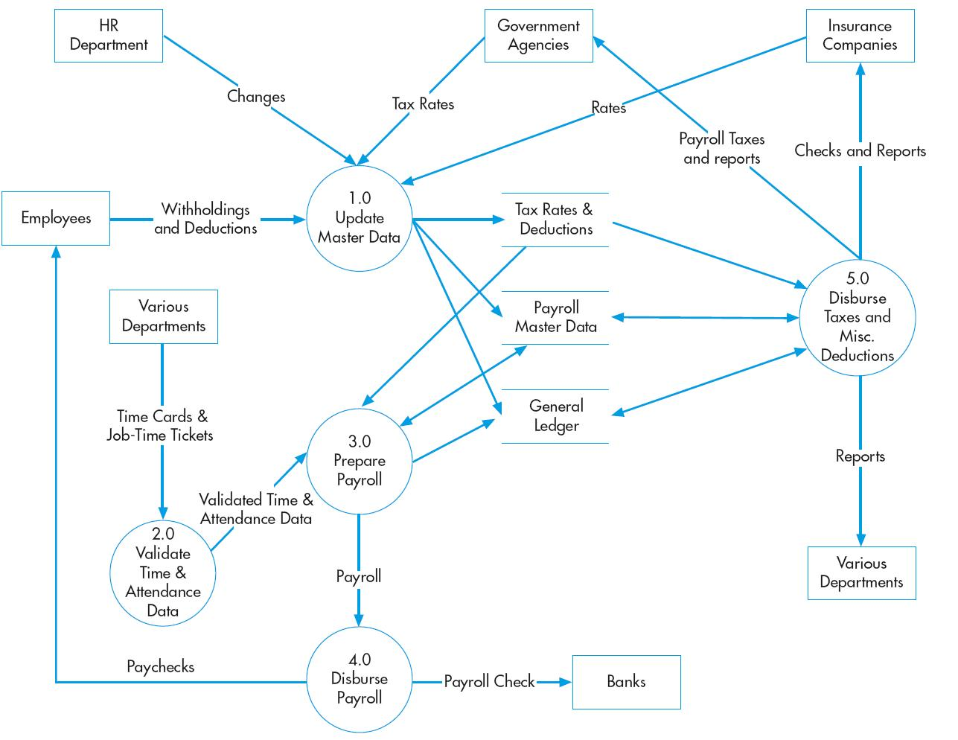
HRM and Payroll Cycle Activities
Update master data
Validate time and attendance
Prepare payroll
Distribute payroll
Disburse taxes and miscellaneous deductions
Copyright © 2012 Pearson Education, Inc. publishing as Prentice Hall
15-11

Slide 12
HRM and Payroll General Threats
Inaccurate or invalid master data
Unauthorized disclosure of sensitive information
Loss or destruction of data
Hiring unqualified or larcenous employees
Violations of employment laws
Copyright © 2012 Pearson Education, Inc. publishing as Prentice Hall
15-12

Slide 13
HRM and Payroll General Controls
Data processing integrity controls
Restriction of access to master data
Review of all changes to master data
Access controls
Encryption
Backup and disaster recovery procedures
Sound hiring procedures, including verification of job applicants’ credentials, skills, references, and employment history
Criminal background investigation checks of all applicants for finance-related positions
Thorough documentation of hiring, performance evaluation, and dismissal procedures
Copyright © 2012 Pearson Education, Inc. publishing as Prentice Hall
15-13

Slide 14
PAYROLL CYCLE ACTIVITIES
The seven basic activities in the payroll cycle are:
  (1) Update payroll master file
  (2) Update tax rates and deductions
  (3) Validate time and attendance data
  (4) Prepare payroll
  (5) Disburse payroll
  (6) Calculate employer-paid benefits and taxes
  (7) Disburse payroll taxes and miscellaneous deductions

Slide 15
(1) UPDATE PAYROLL MASTER FILE
The HRM department provides information on new hires, terminations, changes in pay rates, and changes in discretionary withholdings.
Appropriate edit checks, such as validity checks on employee number and reasonableness tests are applied to all change transactions.
Changes must be entered in a timely manner and reflected in the next pay period.
Records of terminated employees should not be deleted immediately as some year-end reports (e.g., W-2s) require data on compensation for all employees during the year.

Slide 16
(2) UPDATE TAX RATES AND DEDUCTIONS
The payroll department receives notification of changes in tax rates and other payroll deductions from government agencies, insurers, unions, etc.
These changes occur periodically.

Slide 17
(3) VALIDATE TIME AND ATTENDANCE DATA
Most employees are paid either on an hourly basis or a fixed salary.
  Many companies use a time card to record their arrival and departure time.
    This document typically includes total hours worked during a pay period.
  Manufacturing companies may use job time tickets to record not only time present but also time dedicated to each job.
  Employees that earn a fixed salary, e.g., managers and professional staff:
  Usually don’t record their time, but supervisors informally monitor their presence.

Slide 18
(3)VALIDATE TIME AND ATTENDANCE DATA
Accountants and compensation policies
  Recent corporate scandals have led to scrutiny and criticism of executive compensation plans:
    FASB issued new rules requiring that stock options be expensed.
    Major U.S. stock exchanges now require companies to obtain shareholder approval of stock compensation.

Slide 19
(3)VALIDATE TIME AND ATTENDANCE DATA
  Compensation boards are being created to design compensation plans, rather than having executives create their own.
  Accountants can help by:
    Advising on financial and tax effects of proposals.
    Identifying appropriate metrics to measure performance.
    Enabling compliance with legal and regulatory requirements.
    Suggesting appropriate public disclosures.

Slide 20
(3)VALIDATE TIME AND ATTENDANCE DATA
How can information technology help?
  Collecting time and attendance data electronically, e.g.:
    Badge readers
    Electronic time clocks
    Data entered on terminals
    Touch-tone telephone logs
  Using edit checks to verify accuracy and reasonableness when the data are entered.

Slide 21
(4) PREPARE PAYROLL
The employee’s department provides data about hours worked.
A supervisor confirms the data.
Pay rate information is obtained from the payroll master file.
Procedures:
  The payroll transaction file is sorted by employee number (same sequence as master file).
  For each transaction, the payroll master file is read for pay rates, etc., and gross pay is calculated.
    Hourly employees: Gross pay = (hours worked x wage rate) + Overtime + Bonuses
    Salaried employees: Gross pay = Annual salary x Fraction of year worked

Slide 22
(4) PREPARE PAYROLL
  Payroll deductions are summed and subtracted from gross pay to obtain net pay. There are two types of deductions:
    Payroll tax withholdings
    Voluntary deductions
  Year-to-date totals for gross pay, deductions, and net pay are calculated, and the master file is updated. Cumulative records are important because:
    Social Security and other deductions cease or decline at certain levels.
    The information will be needed for tax reports.

Slide 23
(4) PREPARE PAYROLL
  The following are printed:
    Paychecks for employees—often accompanied by an earnings statement, which lists pay detail, current and year-to-date.
    A payroll register, which lists each employee’s gross pay, deductions, and net pay in a multi-column format:
      Is used to authorize the transfer of funds to the company’s payroll bank account.
      May be accompanied by a deduction register, listing miscellaneous voluntary deductions for each employee.

Slide 24
(5) DISBURSE PAYROLL
Most employees are paid either by:
  Check
  Direct deposit
  In some industries, such as construction, cash payments may still be made, but does not provide good documentation
Procedures:
  When paychecks have been prepared, the payroll register is sent to accounts payable for review and approval.
  A disbursement voucher is prepared to authorize transfer of funds from checking to the payroll bank account.
    For control purposes, checks should not be drawn on the company’s regular bank account
    A separate account is created for this purpose.
      Limits the company’s loss exposure.
      Makes it easier to reconcile payroll and detect paycheck forgeries.

Slide 25
(5) DISBURSE PAYROLL
  The approved disbursement voucher and payroll register are sent to the cashier. The cashier:
      Reviews the documents.
      Prepares and signs the payroll check to transfer the funds.
      Reviews, signs, and distributes employee paychecks (which separates authorization and recording from distribution of checks).
      Re-deposits unclaimed checks in the company’s bank account.
      Sends a list of these paychecks to internal audit for investigation.
      Returns the payroll register to payroll department, where it is filed with time cards and job time tickets.
      Sends the disbursement voucher to accounting clerk to update general ledger

Slide 26
(5) DISBURSE PAYROLL
Efficiency opportunity: Direct deposit
  Direct deposit can improve efficiency and reduce costs of payroll processing.
    Employee receives a copy of the check and an earnings statement.
    Each bank receives a record of the payroll deposits for that bank via EDI. The record includes:
      Employee number
      Social security number
      Bank account number
      Net pay amount

Slide 27
(6) CALCULATE EMPLOYER-PAID BENEFITS AND TAXES
The employer pays some payroll taxes and employee benefits directly.
  The employer withholds federal and state taxes from employee paycheck, along with Medicare tax, and the employee’s share of Social Security.
  May also withhold voluntary deductions such as union dues, United Way contributions, credit union savings, retirement contributions, etc.
In addition, the employer pays:
  A matching amount of Social Security.
  Federal and state unemployment taxes.
  The employer share of health, disability, and life insurance premiums, as well as pension contributions.
Some companies offer flexible benefit plans, sometimes called cafeteria-style benefit plans.
  These plans offer a menu of options.

Slide 28
(7) DISBURSE PAYROLL TAXES AND MISCELLANEOUS DEDUCTIONS
The company must periodically prepare checks or EFT to pay tax and other liabilities.

Slide 29
OUTSOURCING OPTIONS
Many entities outsource payroll and HRM to:
  Payroll service bureaus
    Maintain the payroll master file and perform payroll processing activities.
  Professional employer organizations (PEOs)
    Perform the services of the payroll service bureau.
    Also administer and design employee benefit plans.
    Generally, more expensive than payroll service bureaus.
    When organizations outsource payroll processing, they send the service bureau or PEO at the end of each period:
    (1) Personnel changes. (2) Employee time and attendance data.
The service bureau or PEO then:
  Prepares paychecks, earnings statements, and a payroll register.
  Periodically produces tax documents.

Slide 30
CONTROL: OBJECTIVES, THREATS, AND PROCEDURES
In the HRM/payroll cycle (or any cycle), a well-designed AIS should provide adequate controls to ensure that the following objectives are met:
  All transactions are properly authorized
  All recorded transactions are valid
  All valid and authorized transactions are recorded
  All transactions are recorded accurately
  Assets are safeguarded from loss or theft
  Business activities are performed efficiently and effectively
  The company is in compliance with all applicable laws and regulations
  All disclosures are full and fair

Slide 31
CONTROL: OBJECTIVES, THREATS, AND PROCEDURES
There are several actions a company can take with respect to any cycle to reduce threats of errors or irregularities. These include:
  Using simple, easy-to-complete documents with clear instructions (enhances accuracy and reliability).
  Using appropriate application controls, such as validity checks and field checks (enhances accuracy and reliability).
  Providing space on forms to record who completed and who reviewed the form (encourages proper authorizations and accountability).

Slide 32
CONTROL: OBJECTIVES, THREATS, AND PROCEDURES
  Pre-numbering documents (encourages recording of valid and only valid transactions).
  Restricting access to blank documents (reduces risk of unauthorized transaction).
  Following is a discussion of threats to the HRM/payroll system, organized around three areas:
  Employment practices
  Payroll processing
  General control issues

Slide 33
THREATS IN EMPLOYMENT PRACTICES
THREAT 1: Hiring unqualified or larcenous (is the crime of stealing) employees
  Why is this a problem?
    Can increase production expenses.
    Can result in theft of assets.
    Can result in civil and criminal penalties for the company (e.g., if an employee attempts to make a bribe).
  Controls:
    State skill qualifications for each position explicitly in the position control report.
    Ask candidates to sign a statement confirming the accuracy of the information on their application.

Slide 34
THREATS IN EMPLOYMENT PRACTICES
    Recent honesty surveys indicate that 30% of Americans are dishonest, 30% are situationally honest, and 40% are honest. Therefore, ask candidates to consent to a thorough background check of their credentials (Their experiences, trainings and achievements), employment history, and credit:
      You cannot conduct these checks without a written consent.
      Discard الاستغناء candidates who refuse to consent.

Slide 35
THREATS IN EMPLOYMENT PRACTICES
THREAT 2: Violation of employment law
  Why is this a problem?
    Can result in stiff government penalties as well as civil suits.
  Controls:
    Carefully document all actions relating to advertising, recruiting, hiring new employees, and dismissal of employees, to demonstrate compliance.
    Provide employees with continual training to keep them current with employment law.

Slide 36
THREATS IN PAYROLL PROCESSING
THREAT 3: Unauthorized changes to the payroll master file
  Why is this a problem?
    Can increase expenses if wages, salaries, commissions, or base rates are falsified.
    Can result in inaccurate reporting and erroneous decisions
  Controls:
    Proper segregation of duties:
      Only HRM department should be able to update payroll master file.
      HRM employees should not directly participate in payroll processing or distribution.
        Prevents the creation of ghost employees and fraudulent checks.
      Changes to the payroll master file should be reviewed and approved by someone other than the person recommending the change.
        Department supervisors should receive copies of these documents for review.

Slide 37
THREATS IN PAYROLL PROCESSING
    Restrict logical and physical access to the payroll system:
      Utilize user IDs, passwords, and an access control matrix.
      Control terminals from which payroll data and programs can be accessed.
    THREAT 4: Inaccurate time data
  Why is this a problem?
    Can result in payments for services not rendered.
    Inaccurate or missing checks can damage employee morale.
    Can result in inaccurate labor reporting.

Slide 38
THREATS IN PAYROLL PROCESSING
  Controls:
    Automation can reduce unintentional inaccuracies with:
      Badge readers
      Bar code scanners
      Online terminals
    Data entry programs should include edit checks:
      Field checks for employee number and hours worked
      Limit checks on hours worked
      Validity checks on employee numbers
      Segregation of duties can reduce intentional inaccuracies:
      People who process payroll should not have access to payroll master file.
      Supervisors should approve all changes.
    Time clock data should be reconciled to job time tickets by an independent party.
    Supervisors should approve all time cards and job time tickets.

Slide 39
THREATS IN PAYROLL PROCESSING
THREAT 5: Inaccurate processing of payroll
  Why is this a problem?
    Errors damage employee morale, especially if they cause late paychecks.
    Penalties can accrue if:
      Proper payroll taxes are not remitted to the government.
      Court-ordered paycheck garnishments are not made appropriately.
  Controls:
    Batch totals:
      Run and reconcile batch totals before and after processing and at the end of each stage, including hash totals of employee numbers
    Cross-footing of payroll register
      Make sure that sum of rows equals sum of columns, i.e., total of net pay column should equal total of gross pay minus deduction totals.

Slide 40
THREATS IN PAYROLL PROCESSING
  Payroll clearing account
    A general ledger account used in a two-step process:
      First step:
        Payroll control account is debited for amount of gross pay.
        Cash is credited for net pay.
        Various liabilities are credited for withholdings.
      Second step:
        Cost accounting process distributes labor costs to various expense categories and credits payroll control account for sum of the allocations.
    Result should be a zero balance in the control account.

Slide 41
THREATS IN PAYROLL PROCESSING
THREAT 6: Theft or fraudulent distribution of paychecks
  Why is this a problem?
    Payments may be made to fictitious (ghost) or terminated employees, resulting in:
      Increased expenses
      Loss of cash
  Controls:
    Restrict access to blank payroll checks and check signing machine.
    All checks should be sequentially pre-numbered and accounted for periodically.

Slide 42
THREATS IN PAYROLL PROCESSING
      Cashier should sign all checks, but only when supported by proper documentation.
      An imprest payroll bank account should be used.
      Someone independent of the payroll process should reconcile the payroll bank account.
      Segregate duties between those who authorize and record payroll and those who distribute checks and transfer funds.
      Have internal audit observe payroll distribution on a surprise basis.
      Unclaimed checks should be returned to the treasurer’s office for prompt re-deposit and should be investigated.

Slide 43
GENERAL THREATS
THREAT 7: Loss, alteration, or unauthorized disclosure of data
  Why is this a problem?
    Loss or alteration of payroll data can result in delayed and/or inaccurate paychecks and reports.
    Unauthorized disclosure of confidential employee data can violate state and federal laws and damage employee moral.
  Controls:
    Payroll files should be backed up regularly.
      At least one backup on site and one offsite.
    All disks and tapes should have external and internal file labels to reduce chance of accidentally erasing important data.
    Access controls should be utilized:
      User IDs and passwords.
      Compatibility matrices.
      Controls for individual terminals (e.g., so the receiving dock can’t enter a sales order).
      Logs of all activities, particularly those requiring specific authorizations, should be maintained.

Slide 44
GENERAL THREATS
    Default settings on ERP systems usually allow users far too much access to data, so these systems must be modified to enforce proper segregation of duties.
    Sensitive data should be encrypted in storage and in transmission.
    Websites should use SSL for secure employee communications.
    Payroll service bureaus and PEOs can help provide security for data.
    VPNs should be used to exchange data with service bureaus or PEOs.
    Parity checks, acknowledgment messages, and control totals should be used to ensure transmission accuracy.

Slide 45
GENERAL THREATS
THREAT 8: Poor performance
  Why is this a problem?
    May damage employee relations.
    Reduces profitability.
  Controls:
    Prepare and review performance reports.
The payroll system should be integrated with cost data and HR information so management can make decisions with respect to the following types of issues:
  Future work force staffing needs
  Employee performance
  Employee morale
  Payroll processing efficiency and effectiveness.

